Slide 1
Welcome to Sauder
Elementary School

Slide 2
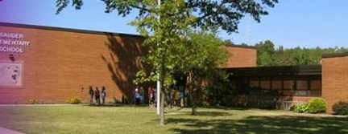
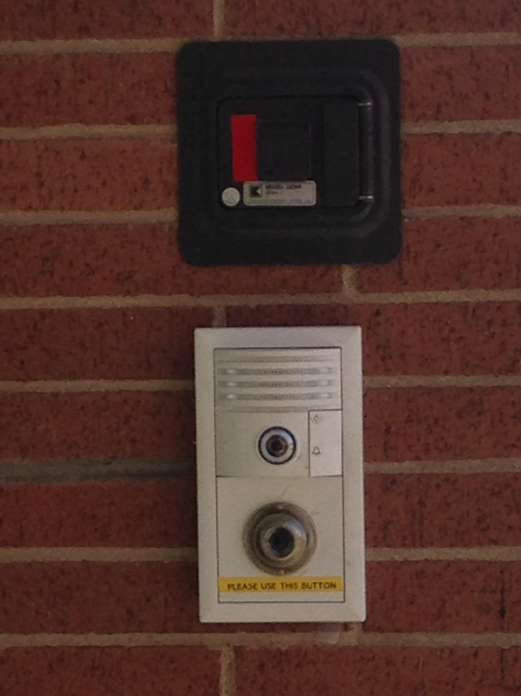
Student and Staff Safety
To enter the building:
Follow the directions on the image to the right.
State your name and the purpose for your visit.
Produce a valid driver’s license.

Slide 3
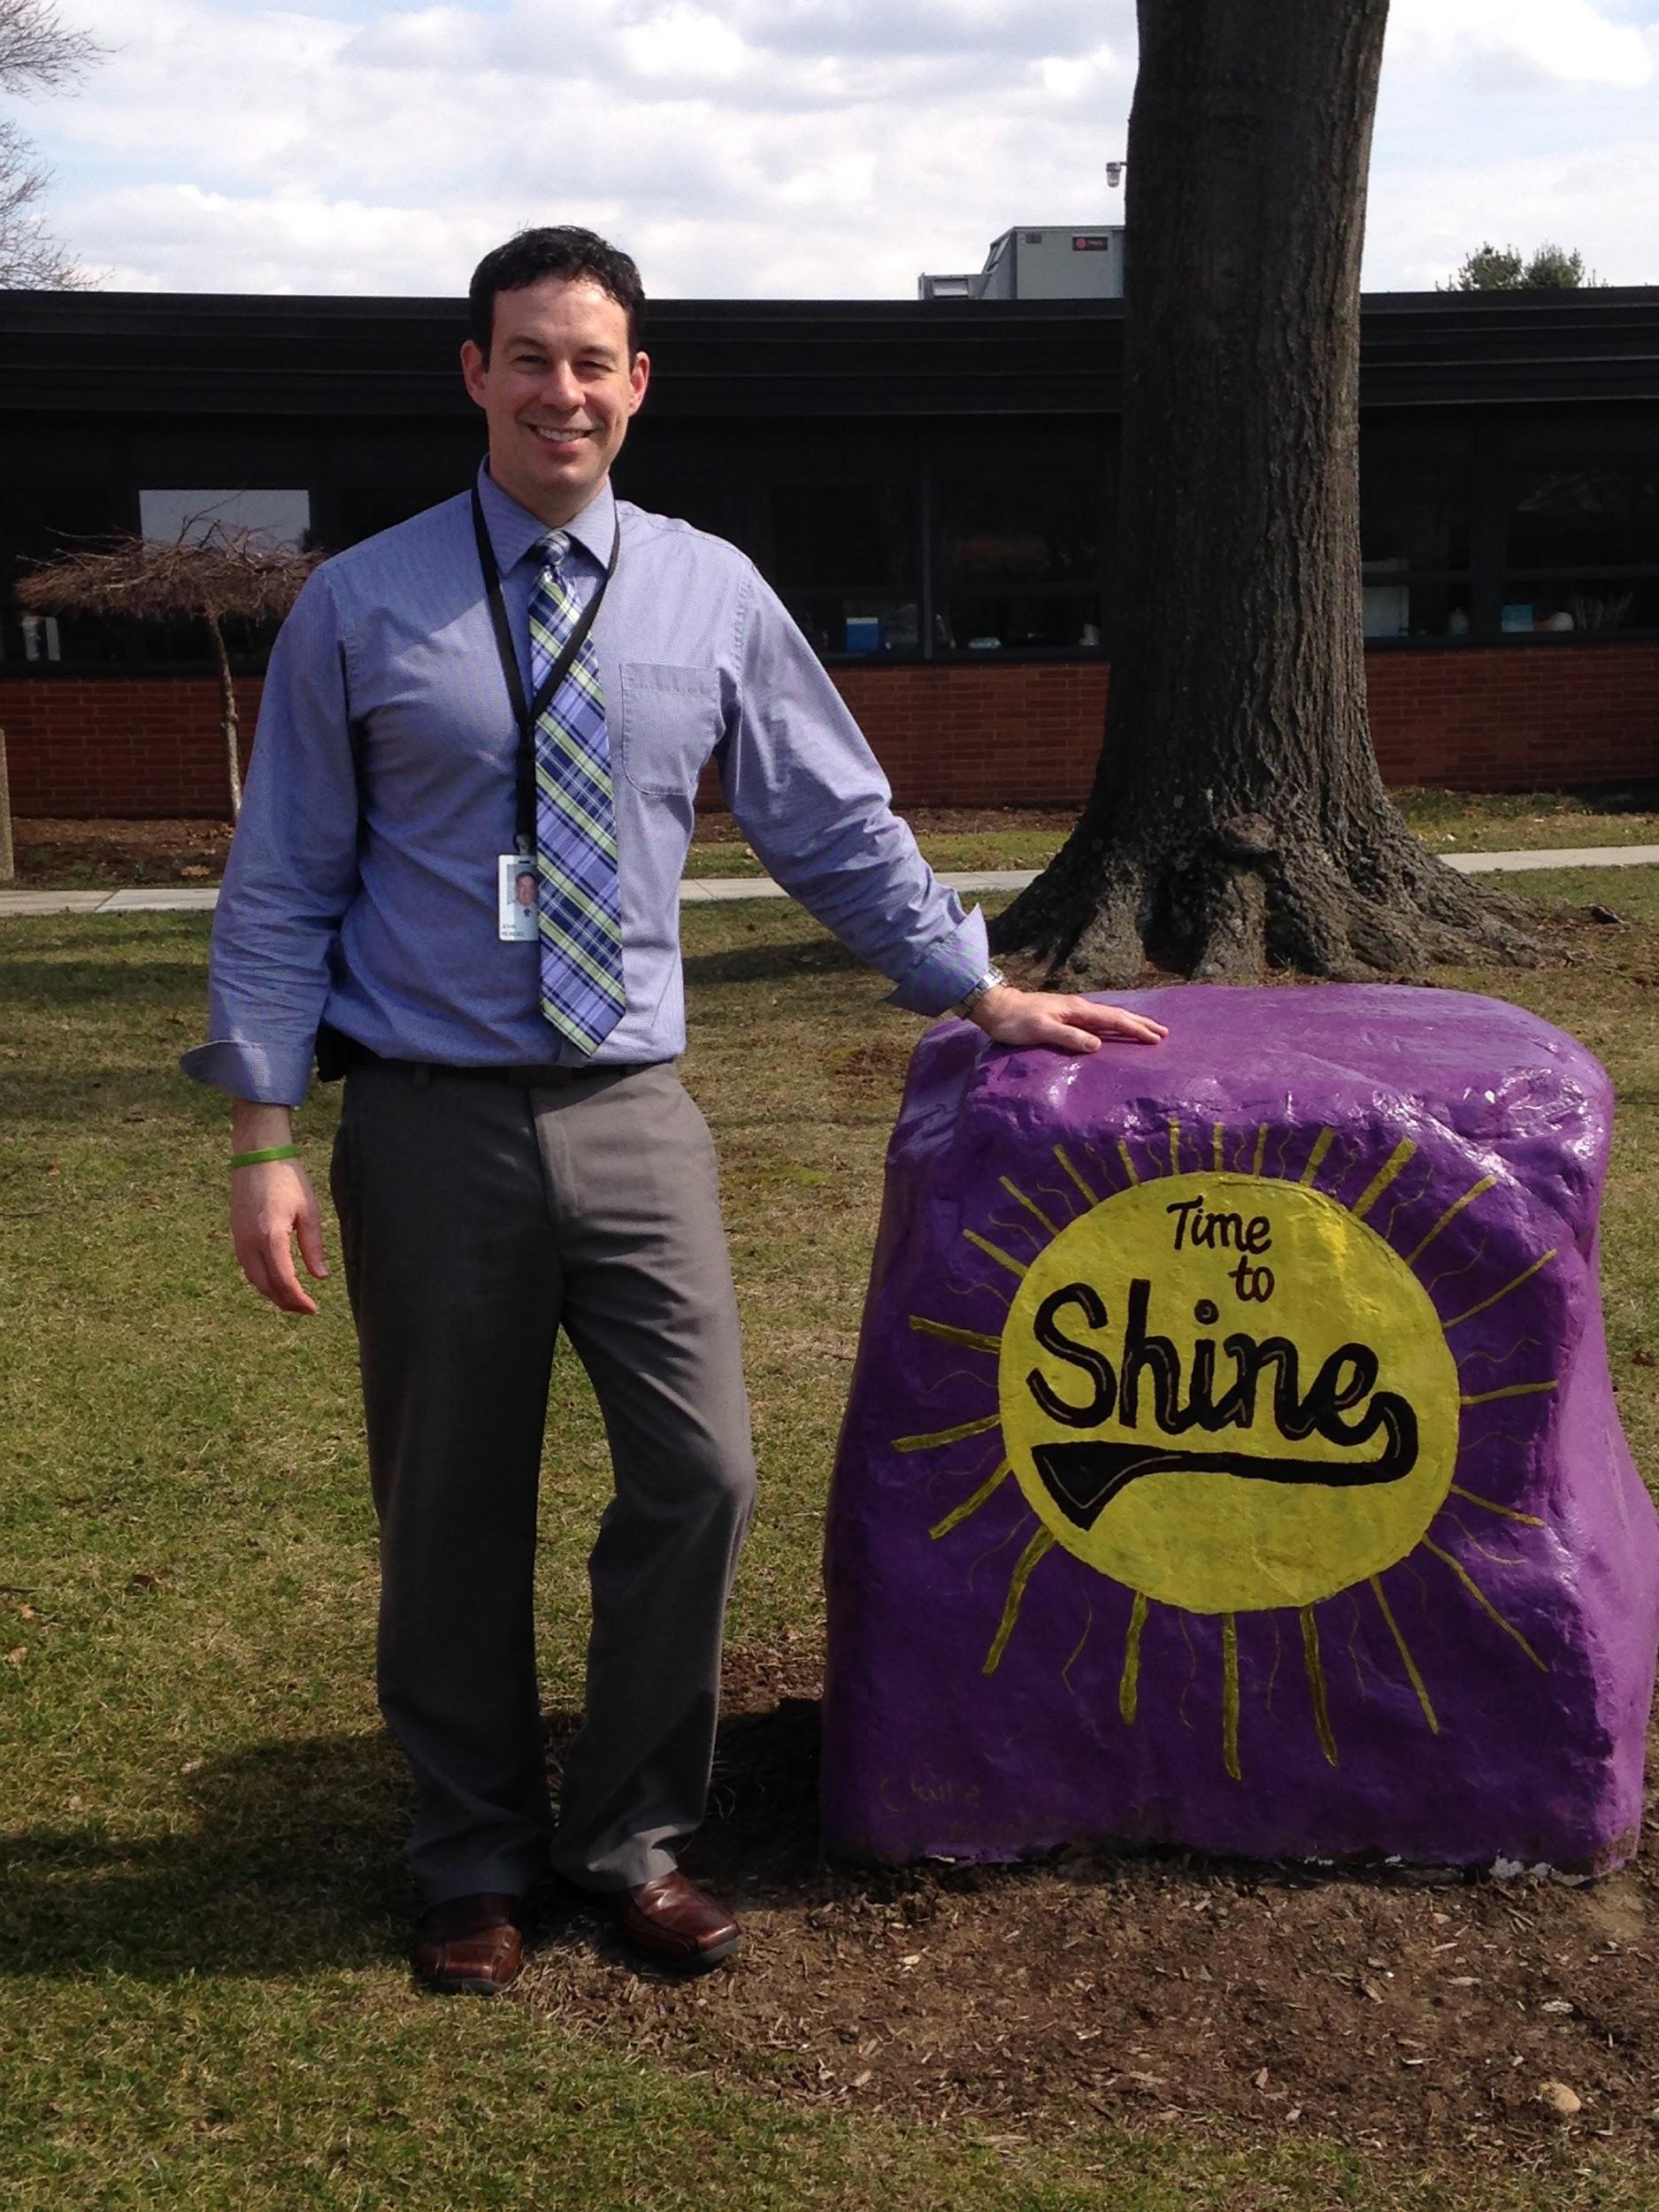
Meet your Principal, Mr. Reindel!
Mr. Reindel welcomes you to Sauder Elementary School. He is very excited that you have joined the Jackson Local Schools community!

Slide 4
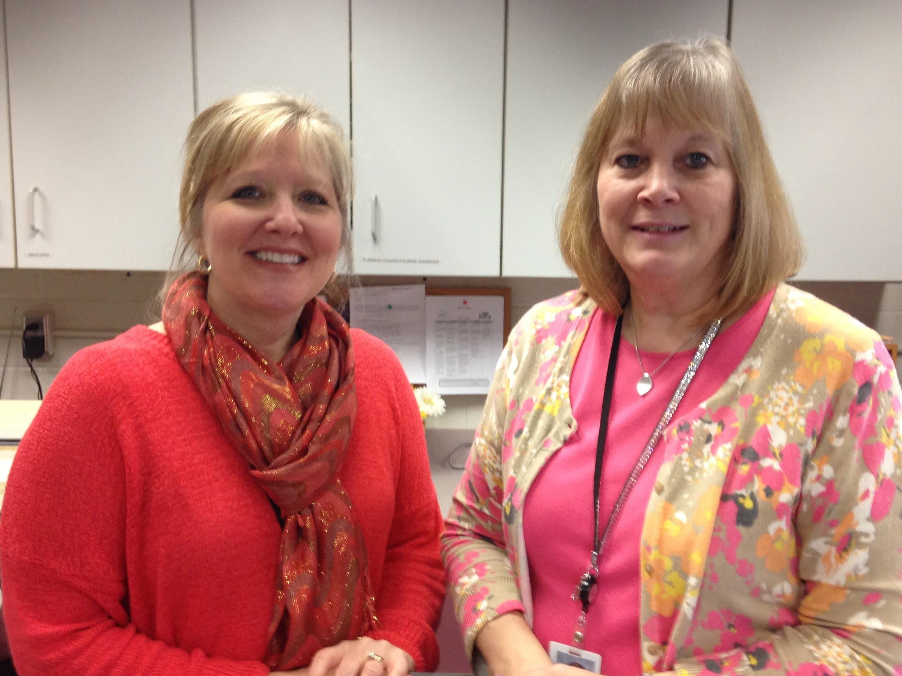
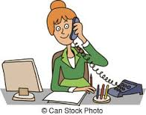
Meet your Building Secretary and Building Aide; Mrs. Kress and Mrs. Hohenadel. Please make sure that notes from home are turned in to your classroom teacher each day. Please include your child’s first and last name, your name, and teacher’s name printed clearly.
Mrs. Hohenadel
Mrs. Kress

Slide 5
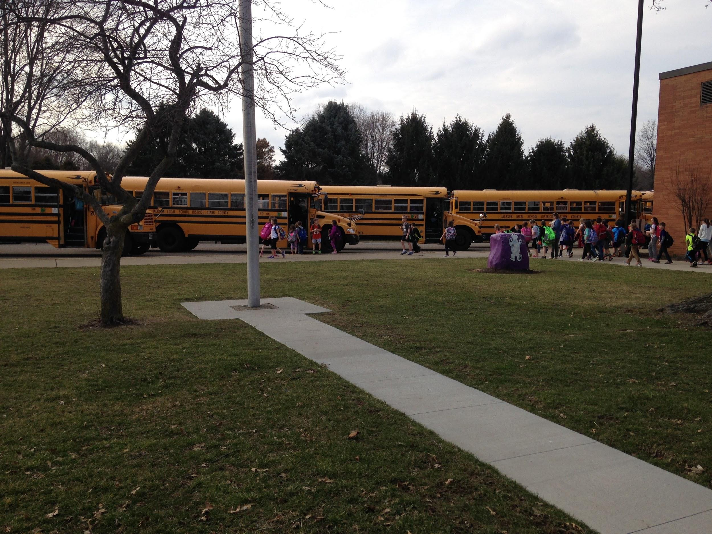
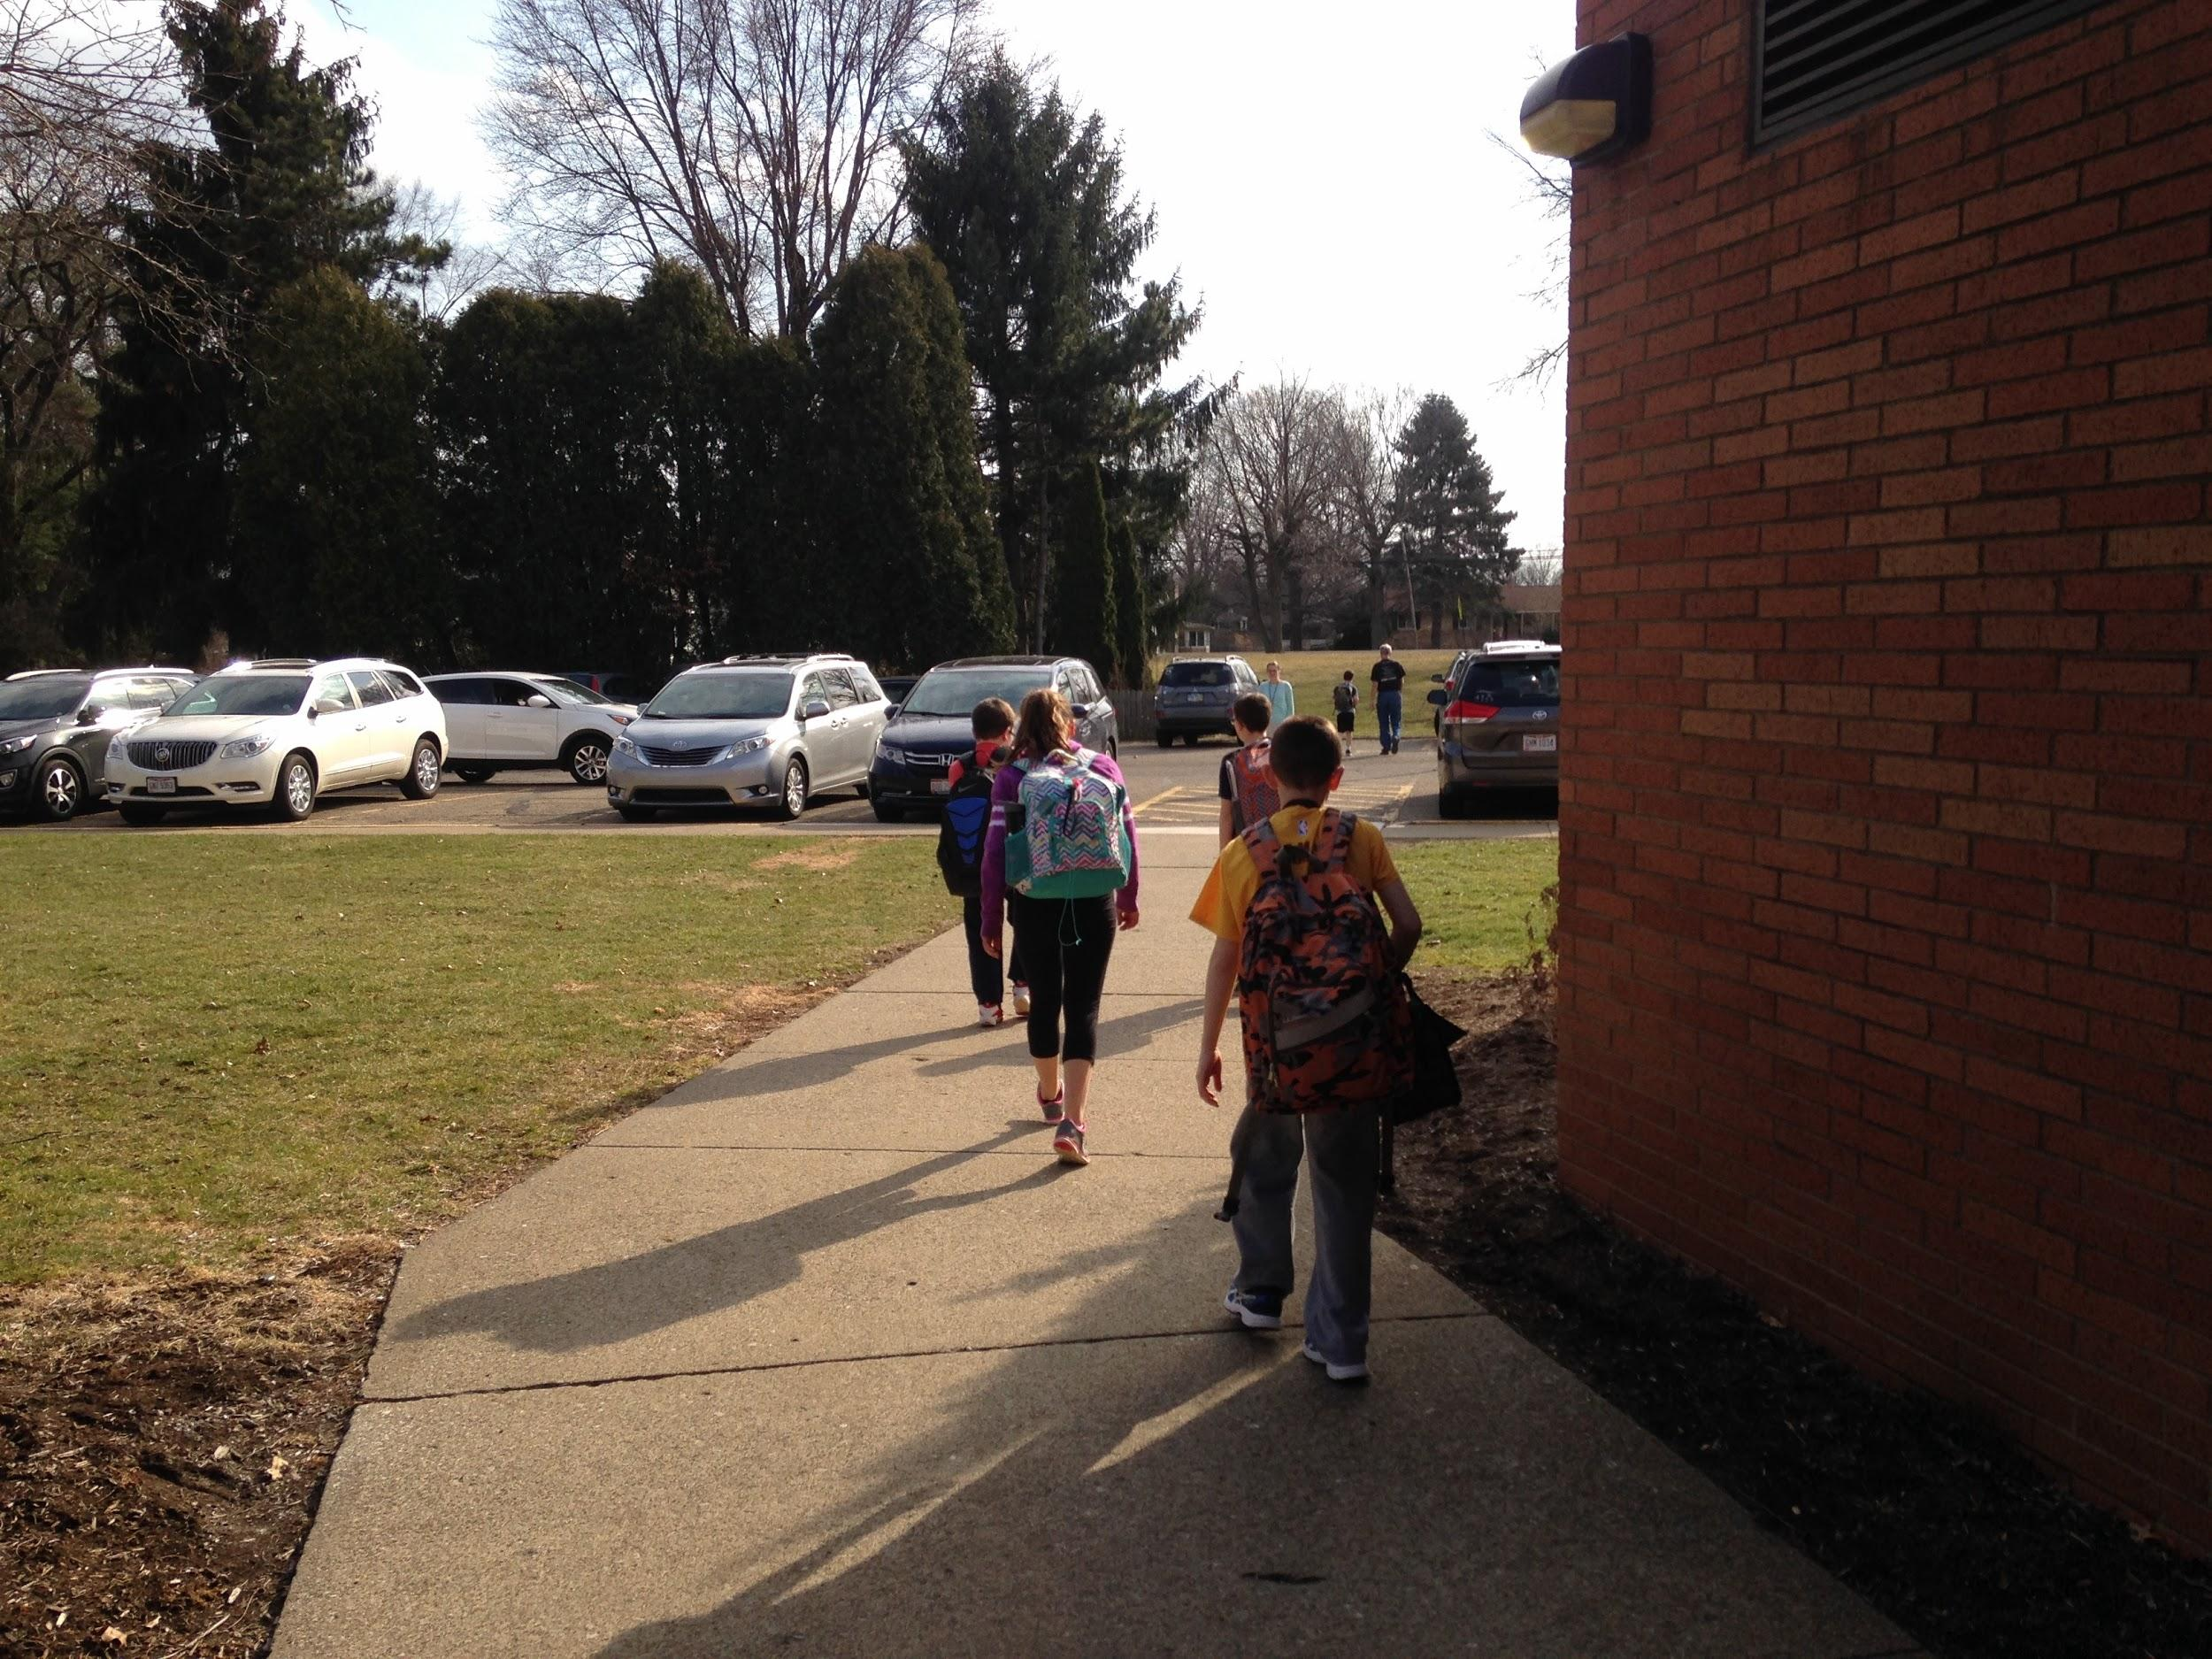
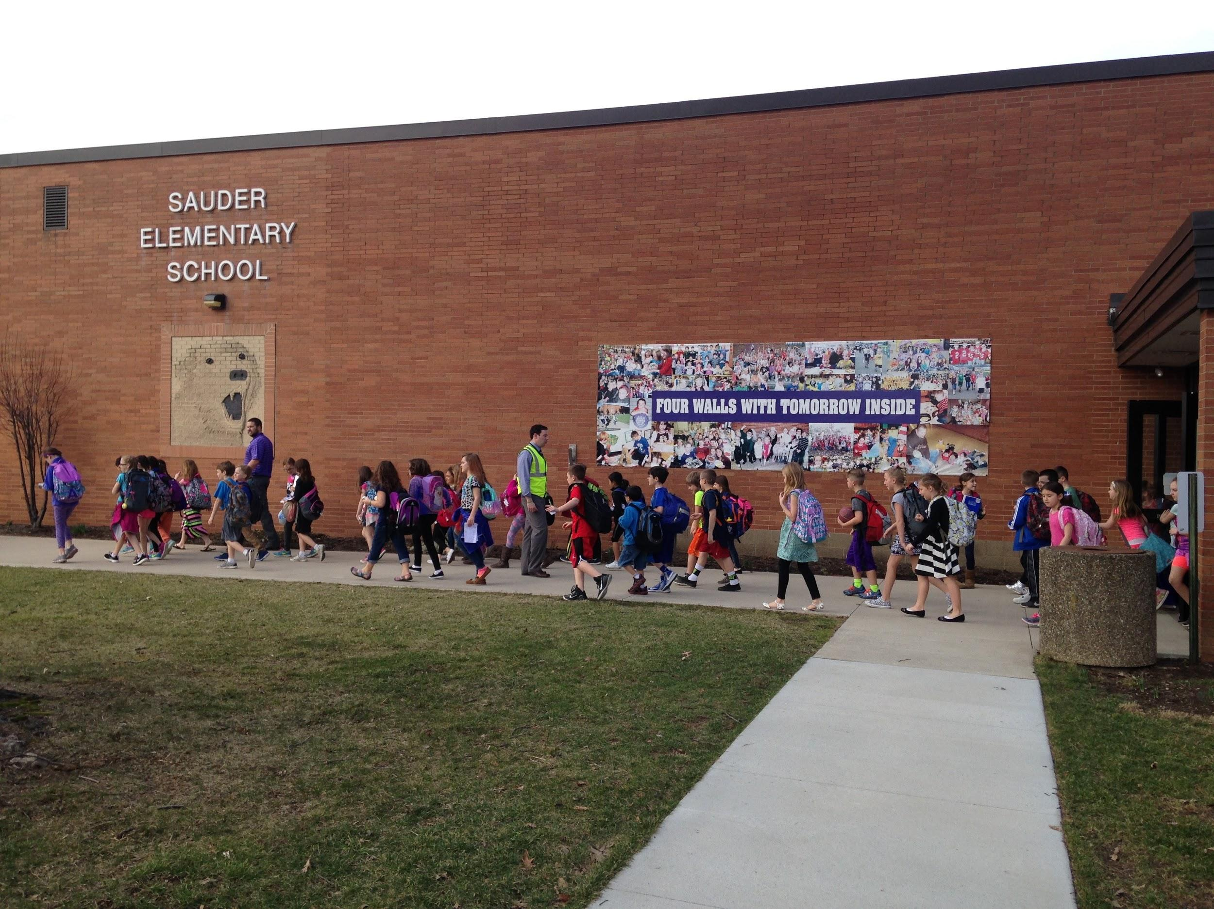
Arriving and departing school
School Bus
Parent Drop-Off

Slide 6
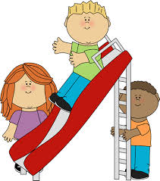
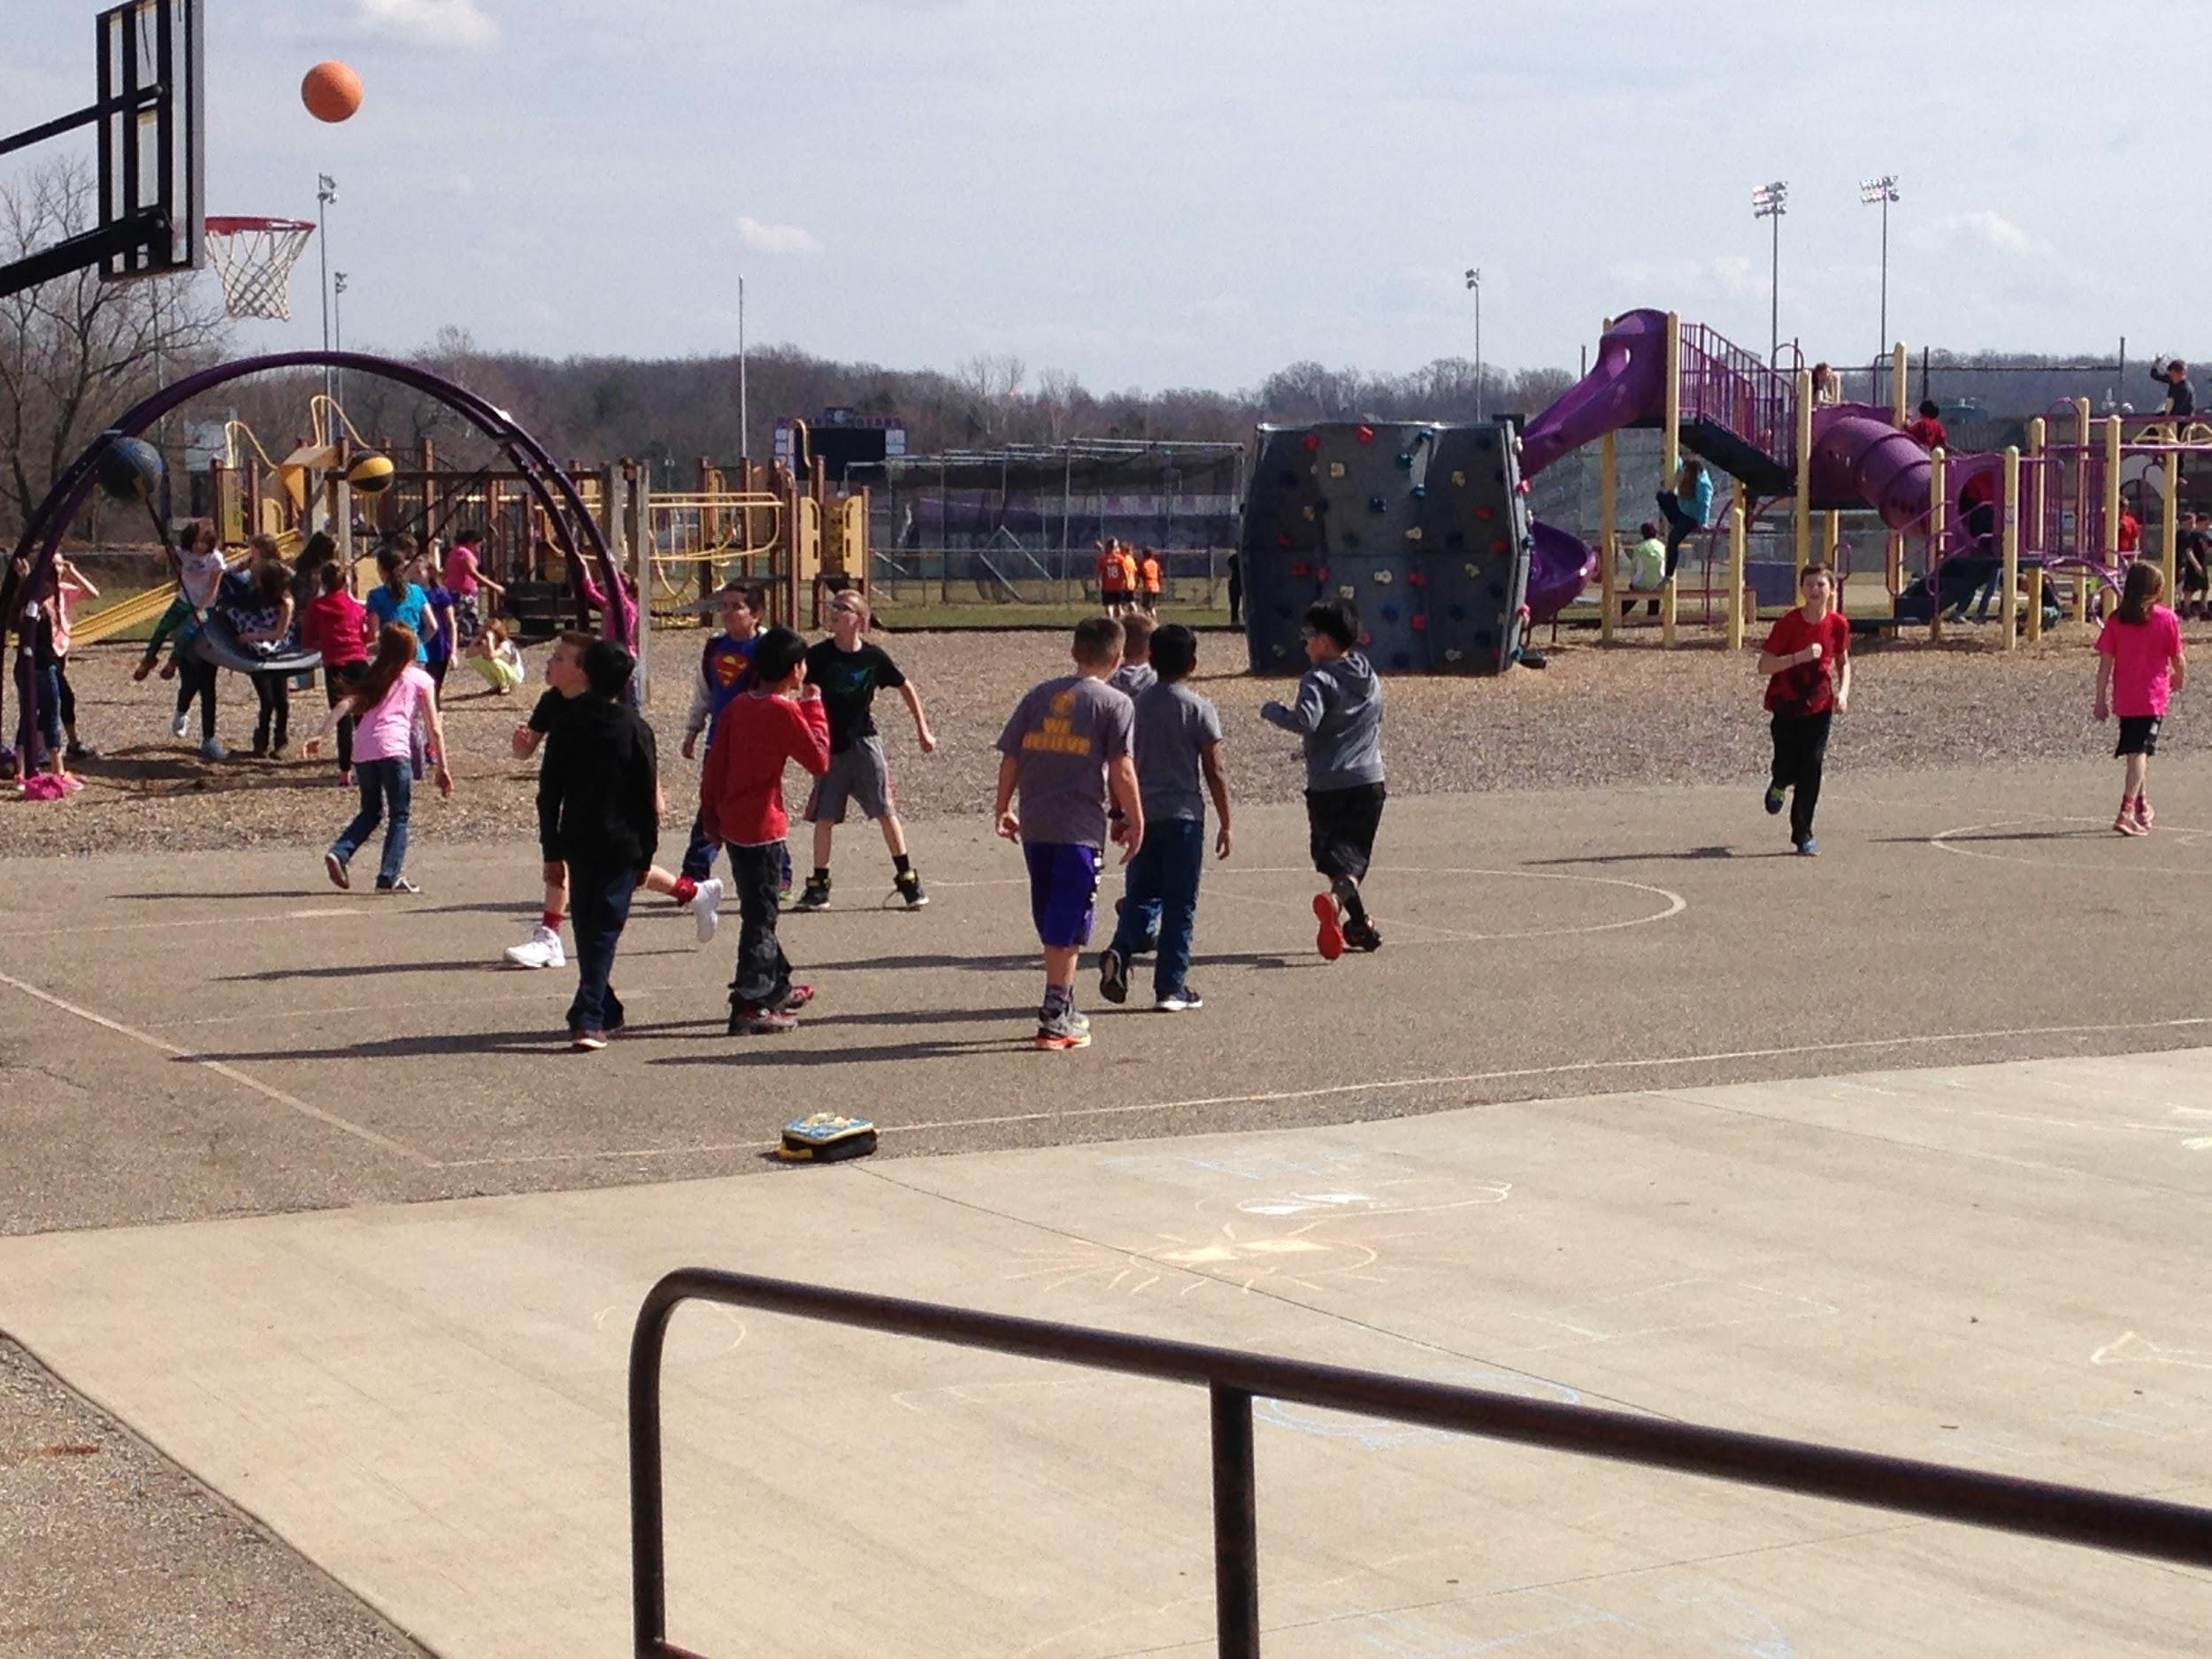
Recess
Recess is 15-20 minutes daily. Please dress for the weather!
Parents, please feel free to bring your child to the playground during non-school hours. They will feel more at ease during recess!

Slide 7
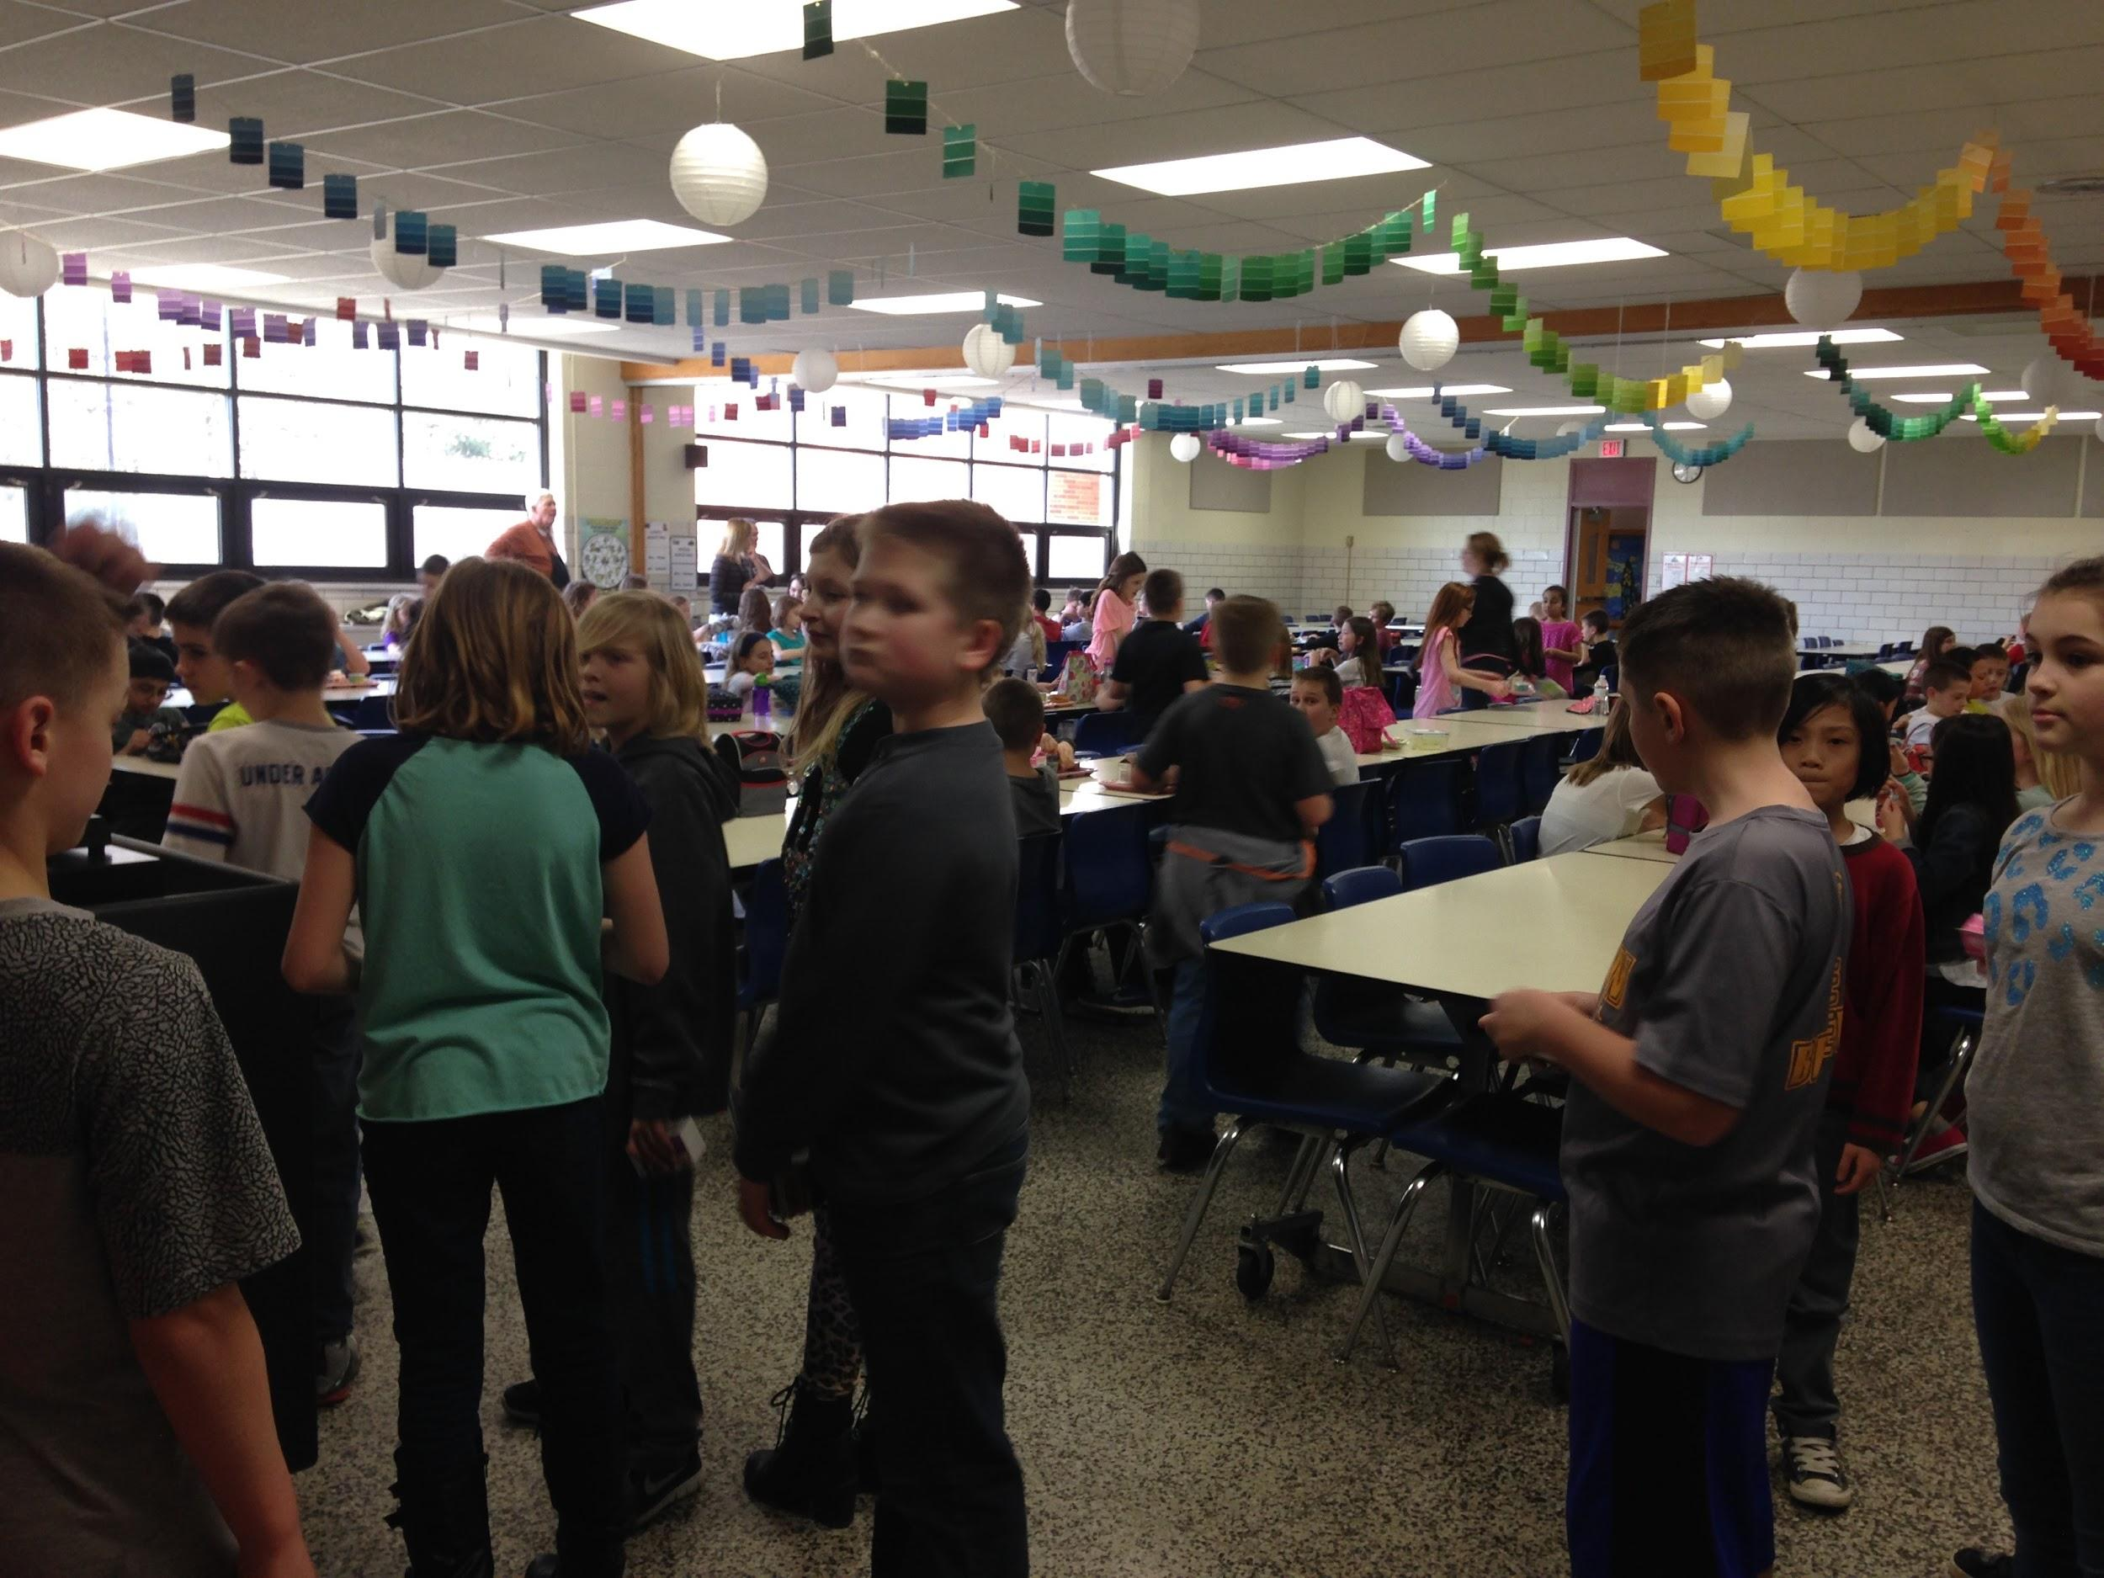
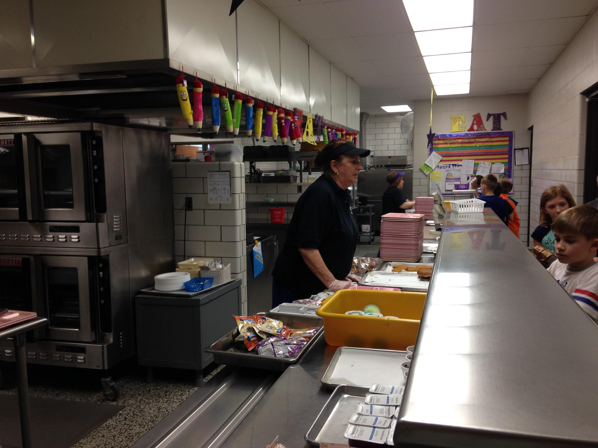
Cafeteria
You have 25 minutes to eat your lunch. You may buy or pack. If you buy, you pay for your lunch using a special code.
Click here for menu!

Slide 8
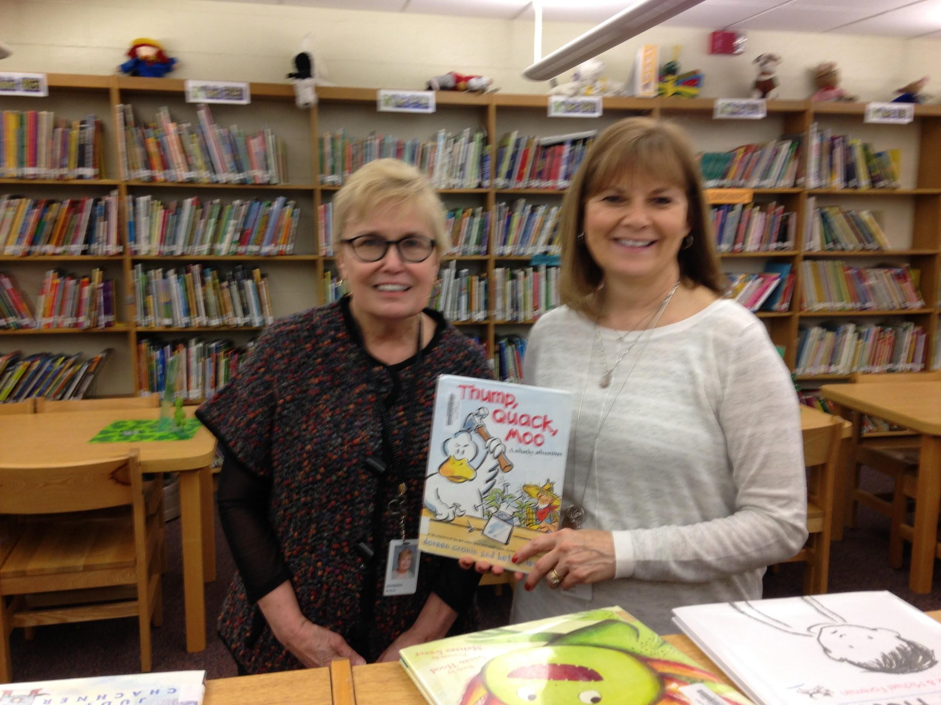
Library
Click here to link to our libraries!
You get to spend 35 minutes per week with Mrs. Koch and Mrs. Marzec. You’ll hear wonderful stories and get to borrow books to read at home.
Would you like to volunteer? Please email Mrs. Koch:
blk2jc@jackson.sparcc.org
Mrs. Koch
Mrs. Marzec

Slide 9
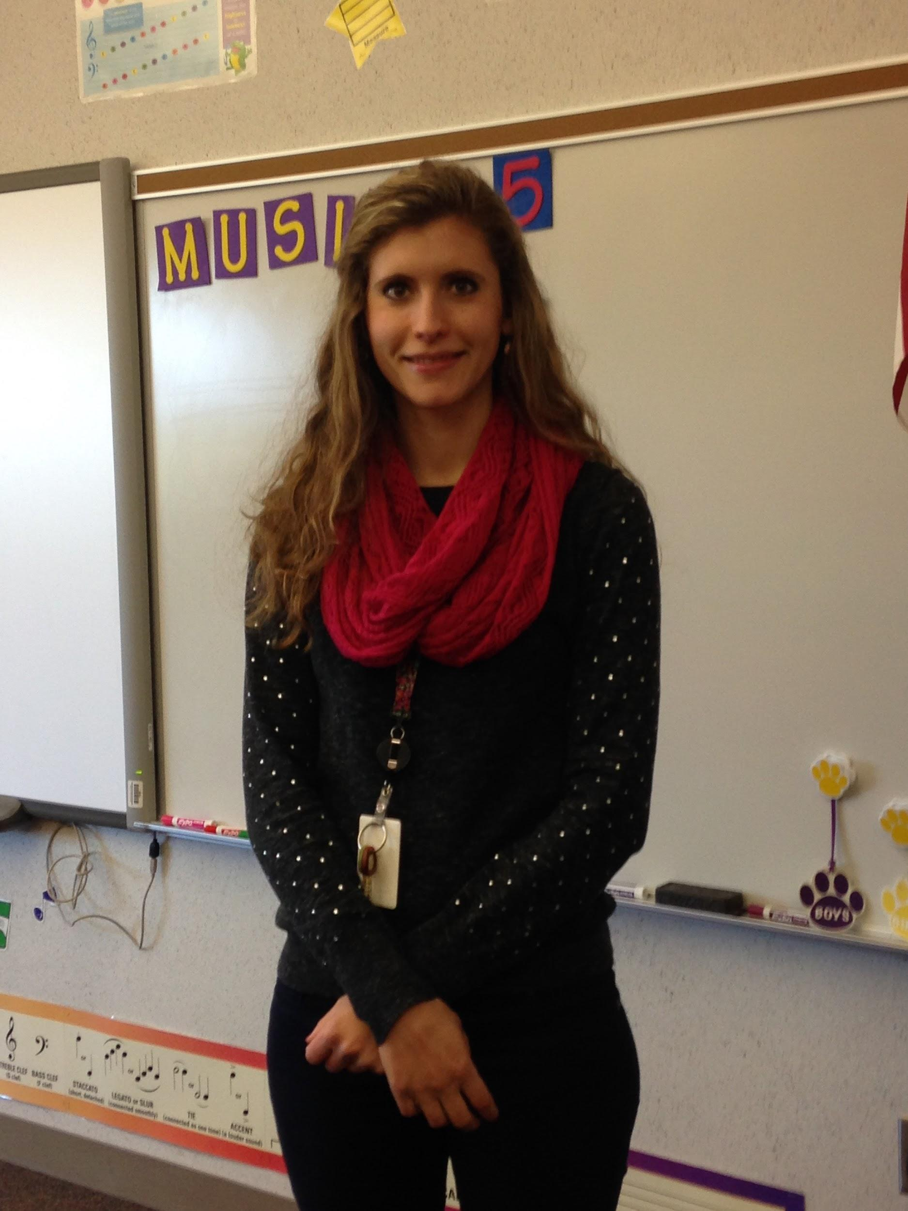
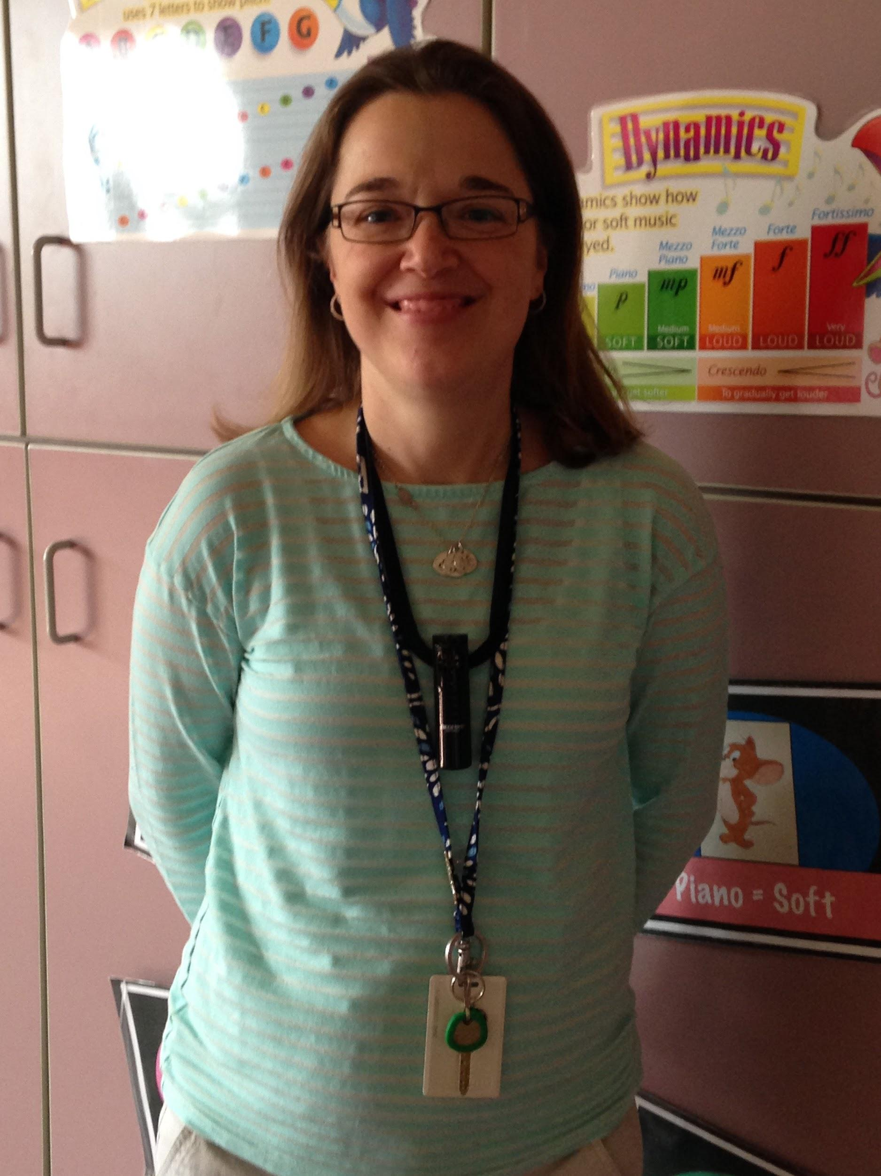
Music
You can enjoy 70 minutes per week with Mrs. Potts or Mrs. Bullach. Singing is so much fun!
Mrs. Potts
Miss Bullach

Slide 10
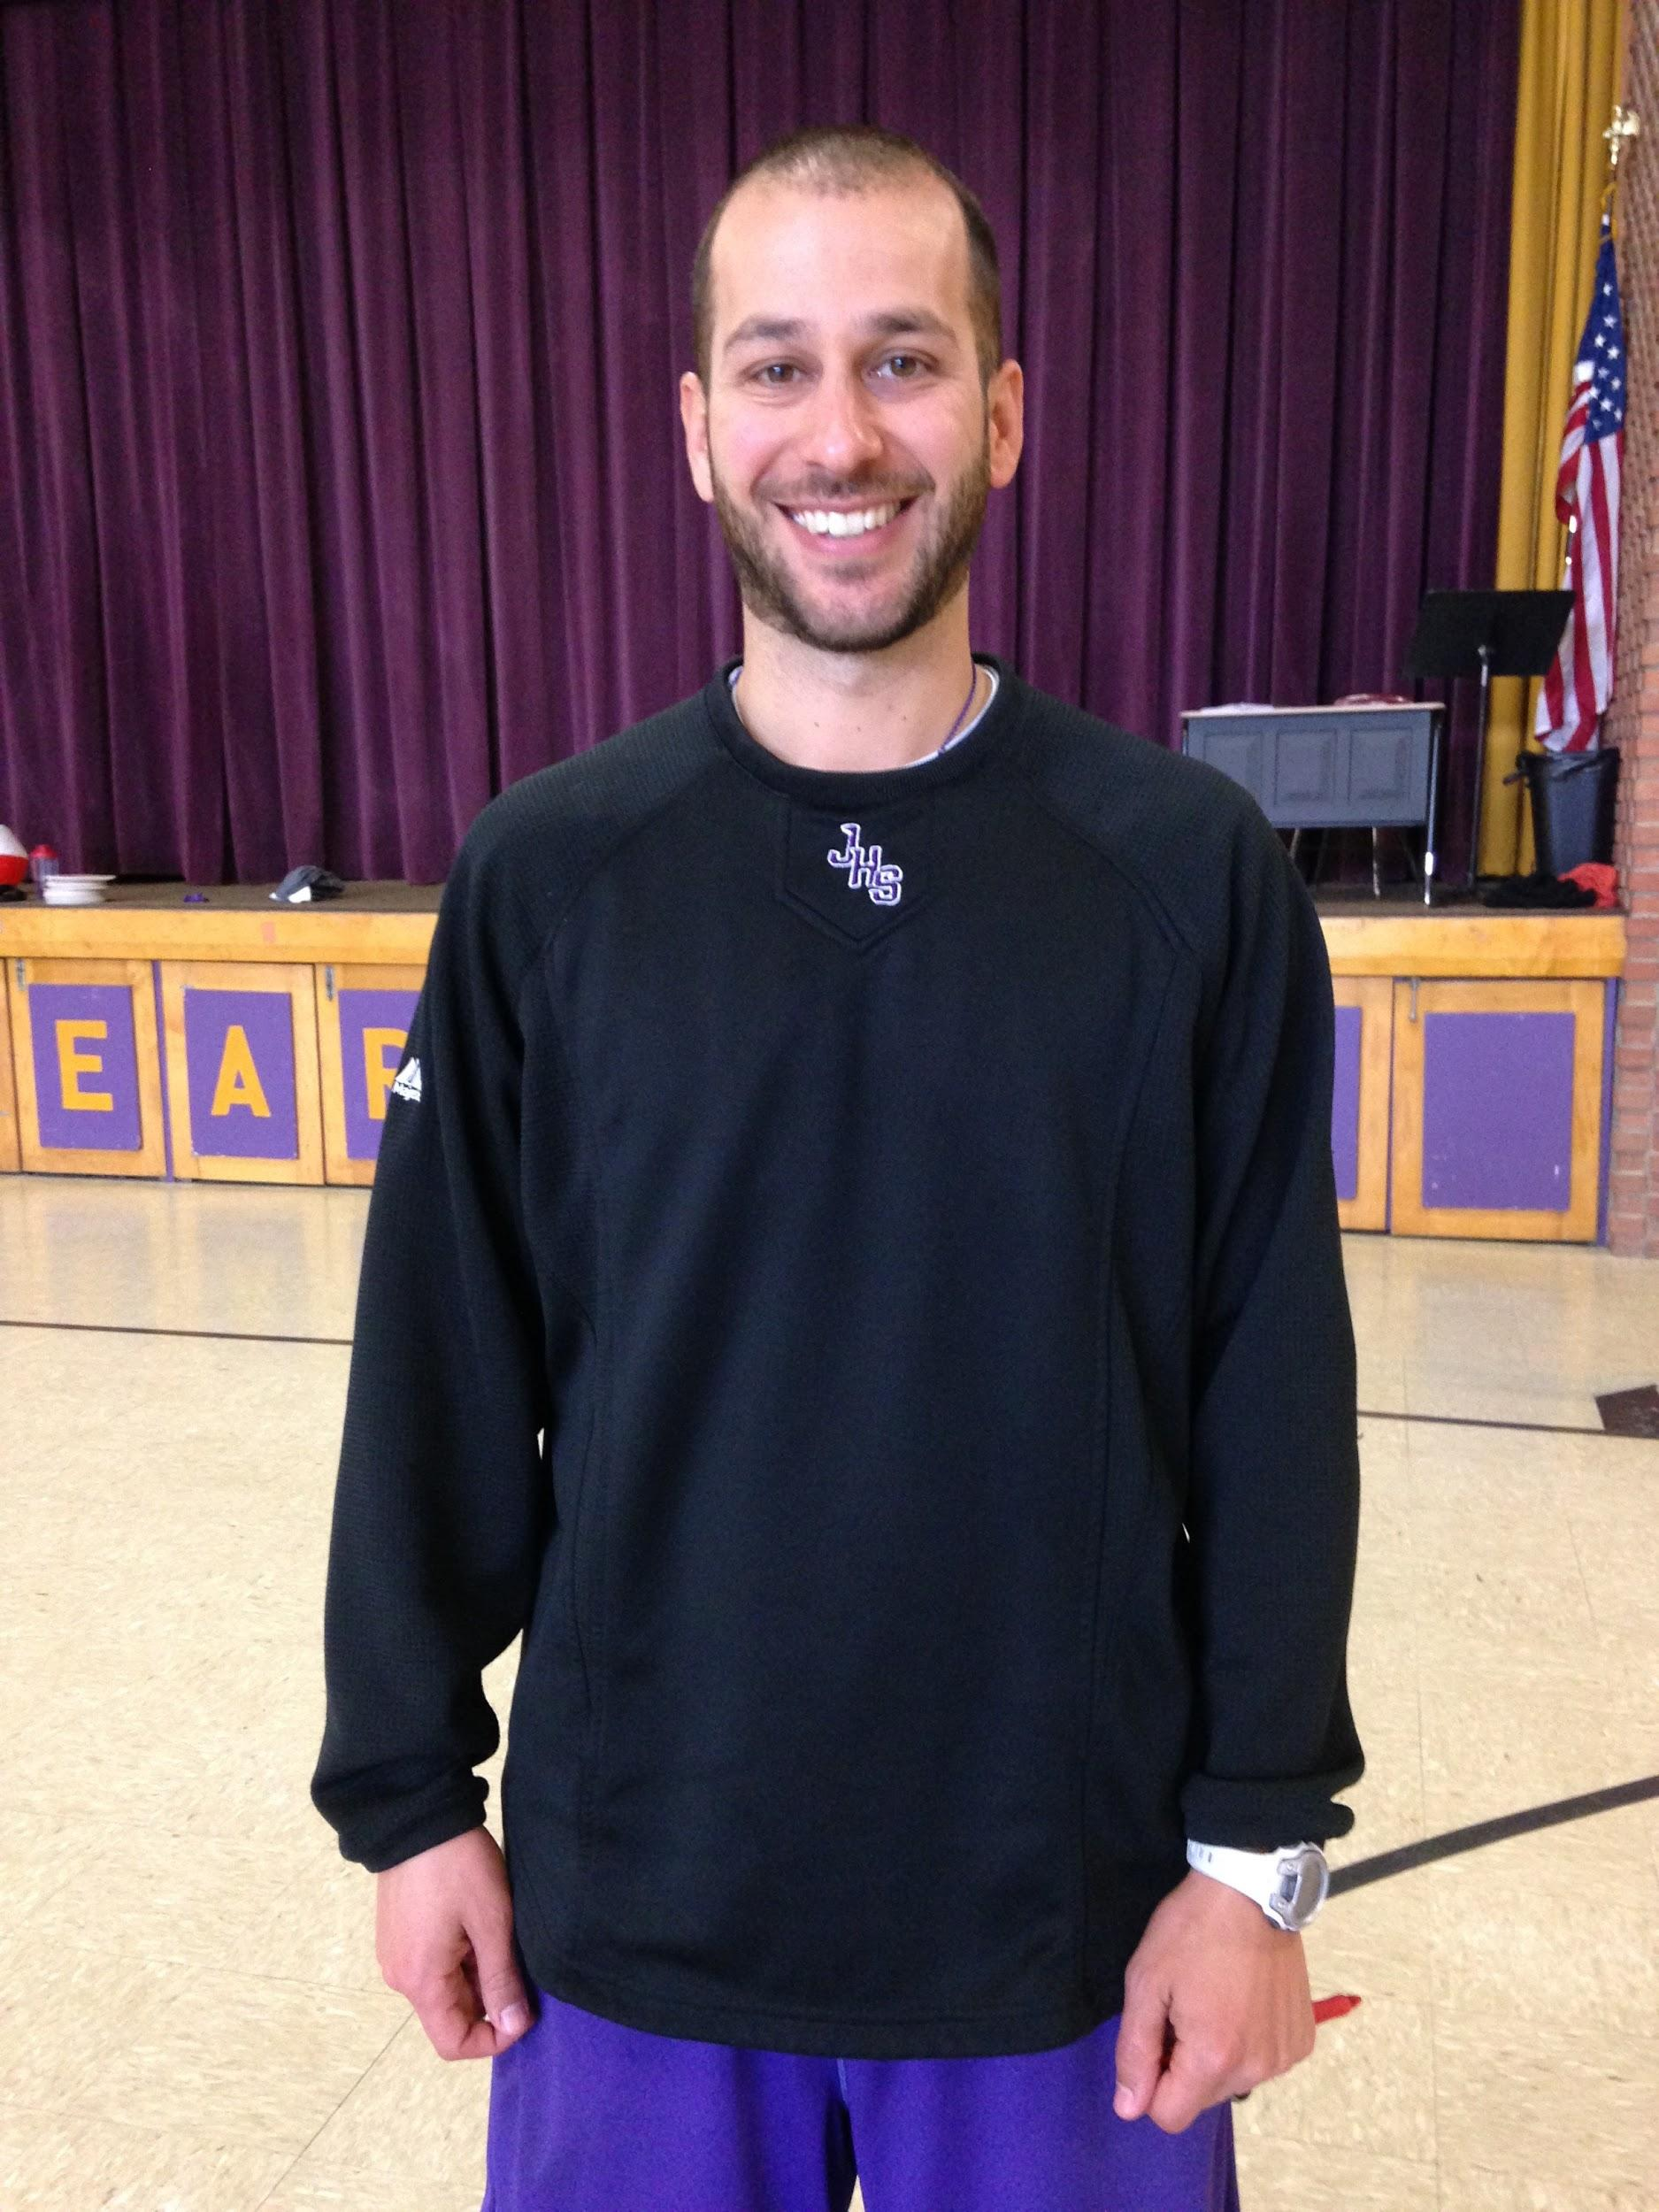
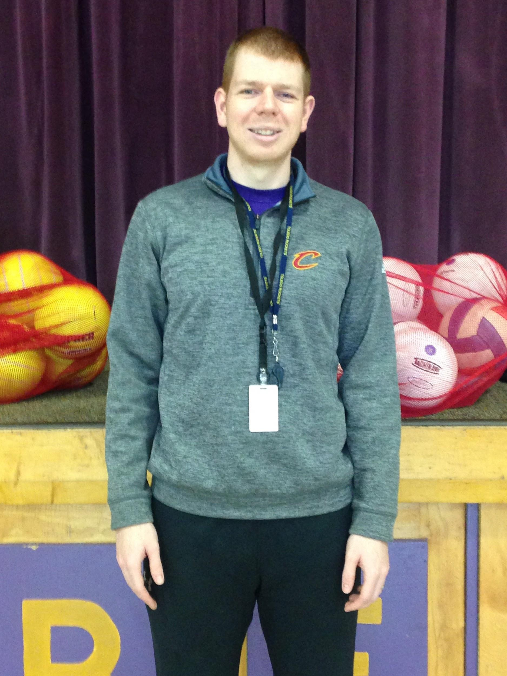
Physical Education
Spend 70 minutes per week with Mr. Rodriguez or Mr. Holecko. They will keep you in tip-top shape!
Mr. Rodriguez
Mr. Holecko

Slide 11
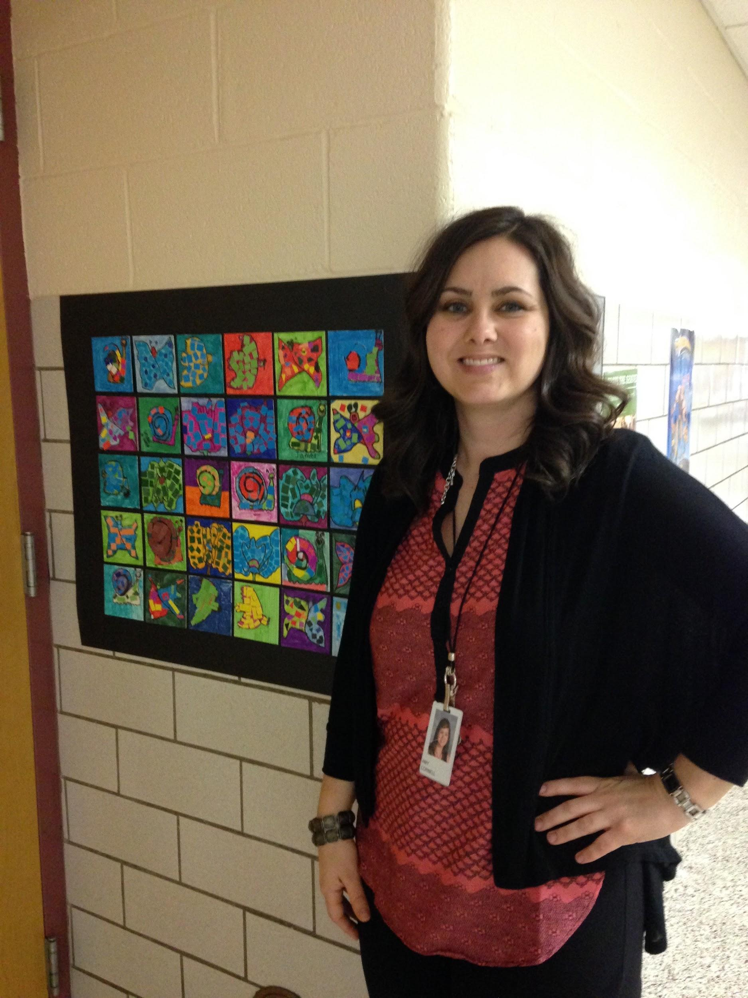
School Counselor
Click here for Mrs. Cornell’s site.
Mrs. Cornell is your building school counselor. She is here to listen and support students. Ask her what it means to be a “Bucket Filler”!

Slide 12
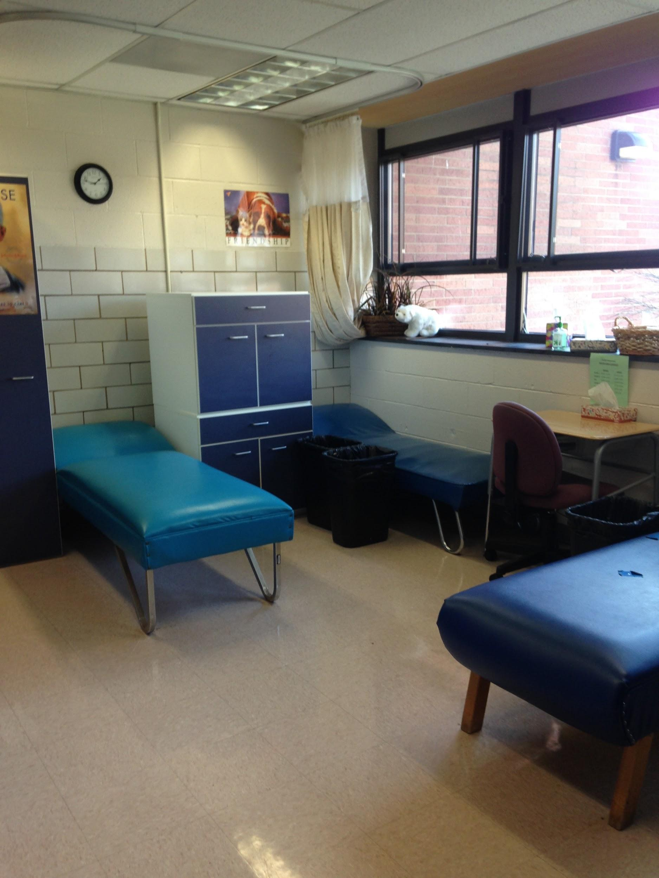
Clinic
If you’re not feeling well, you may visit the clinic. If necessary, your family may be called.

Slide 13
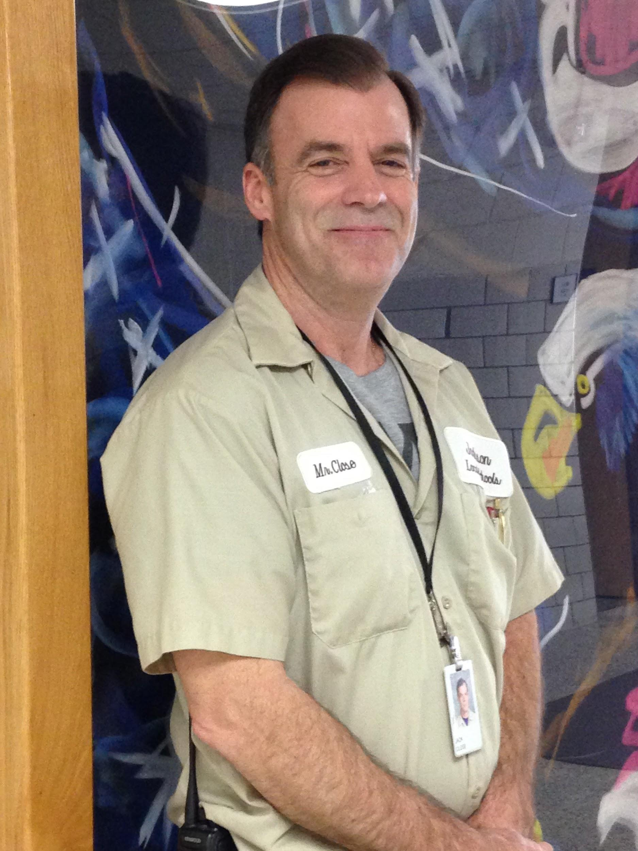
Meet your Custodian!
Mr. Close works hard each day to keep the school clean, safe, and comfortable. You can help him by picking up after yourself.

Slide 14
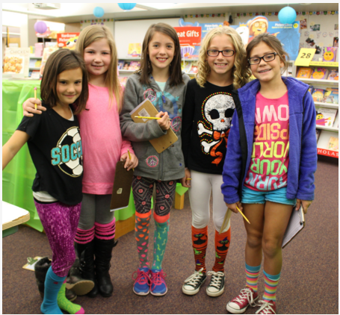
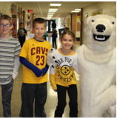
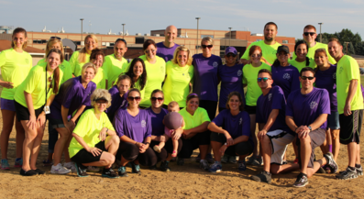
Here’s your tremendous Parent/Teacher Group
Visit their website by clicking here.

Slide 15
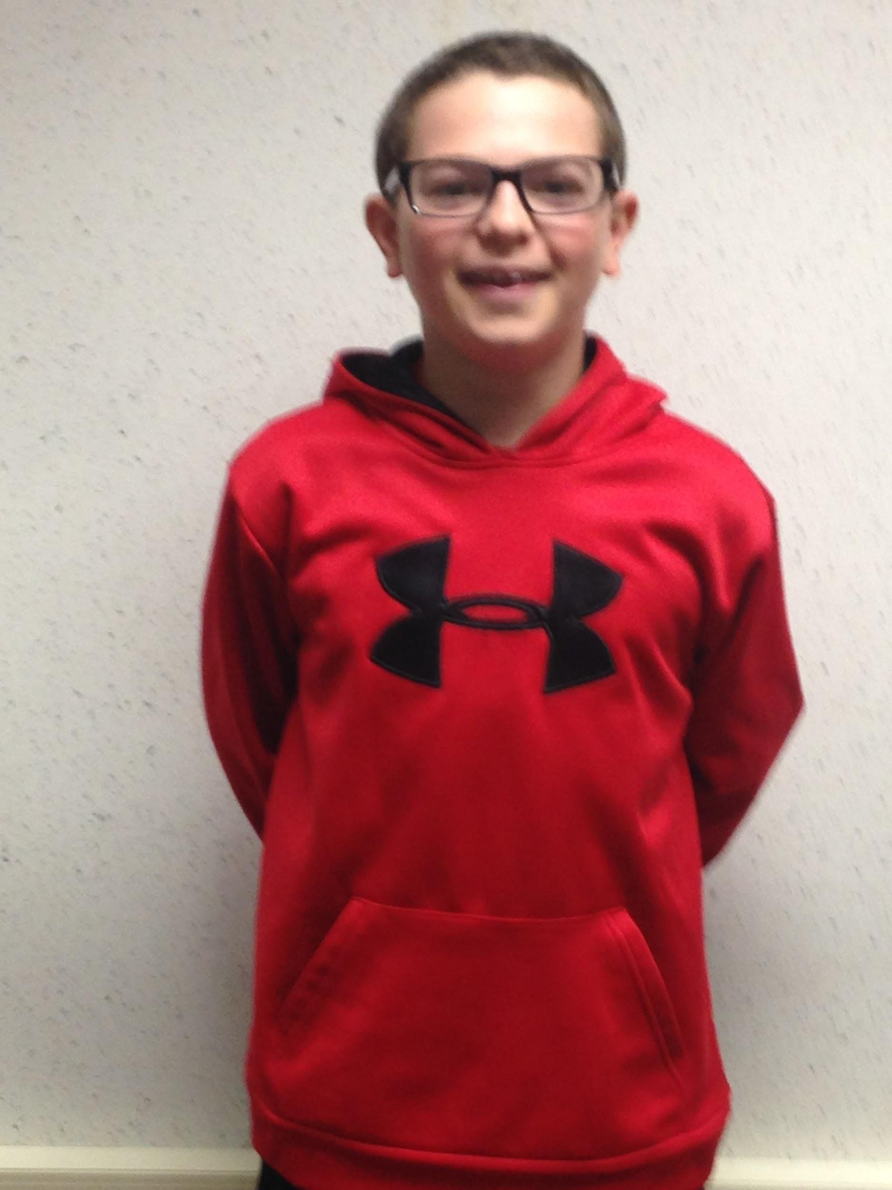
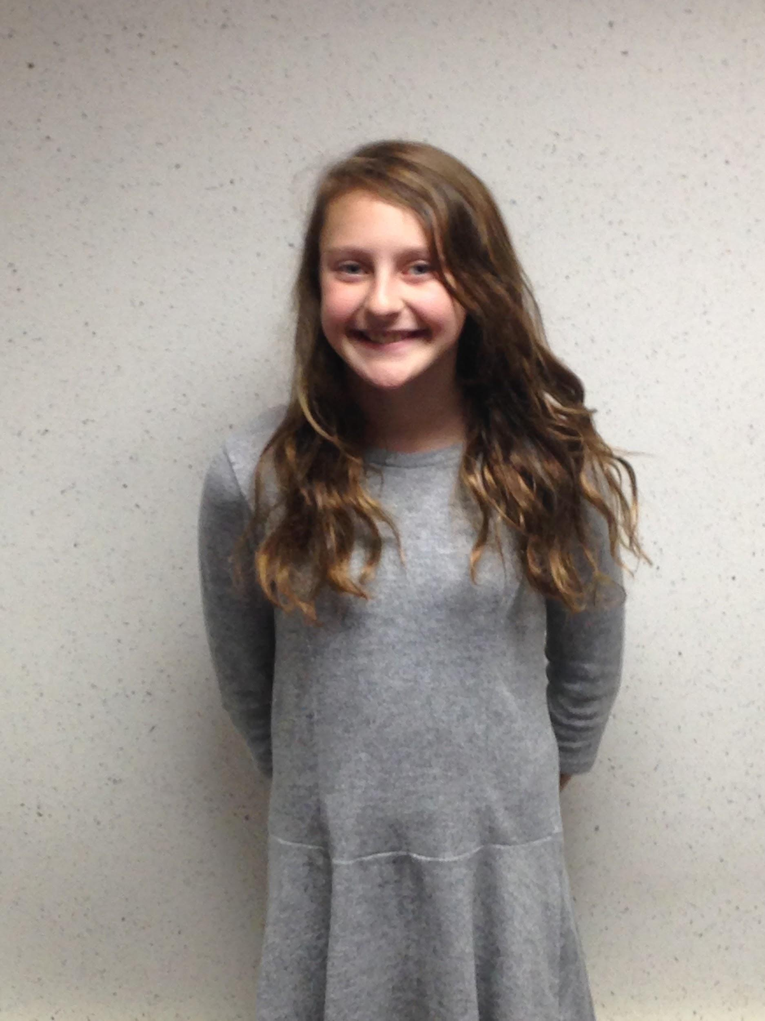
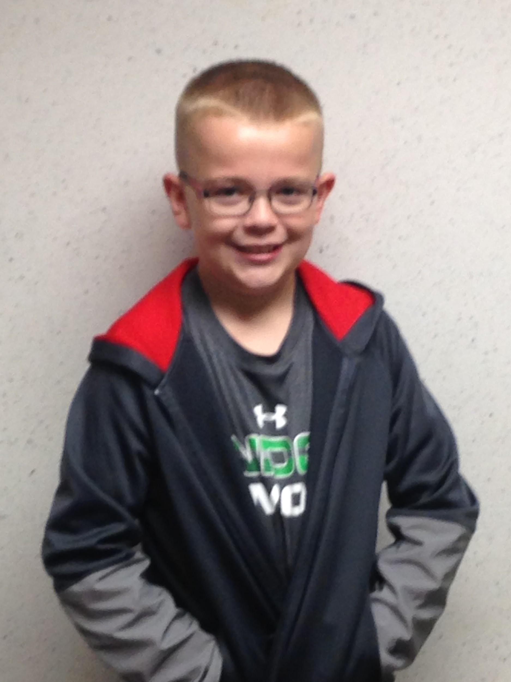
Here are testimonials from students in your building.
Greg C.
Nora E.
Ethan P.
Please click student images in order to hear testimonials.
Notes:
Need names of two students per building-media release

Slide 16
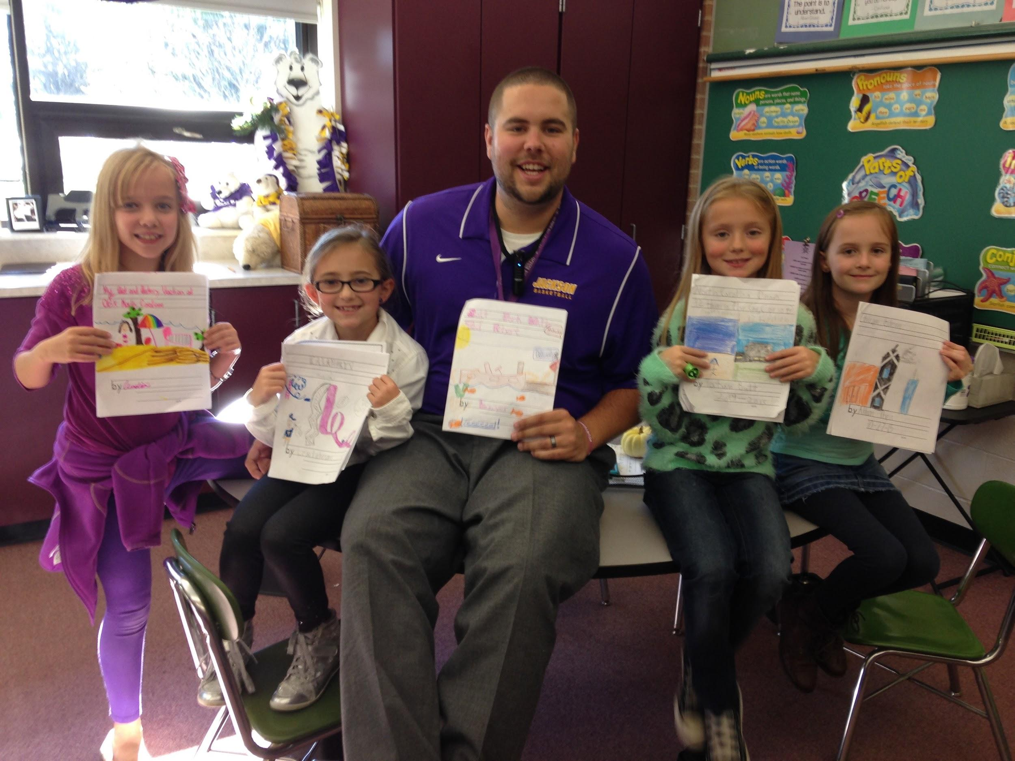
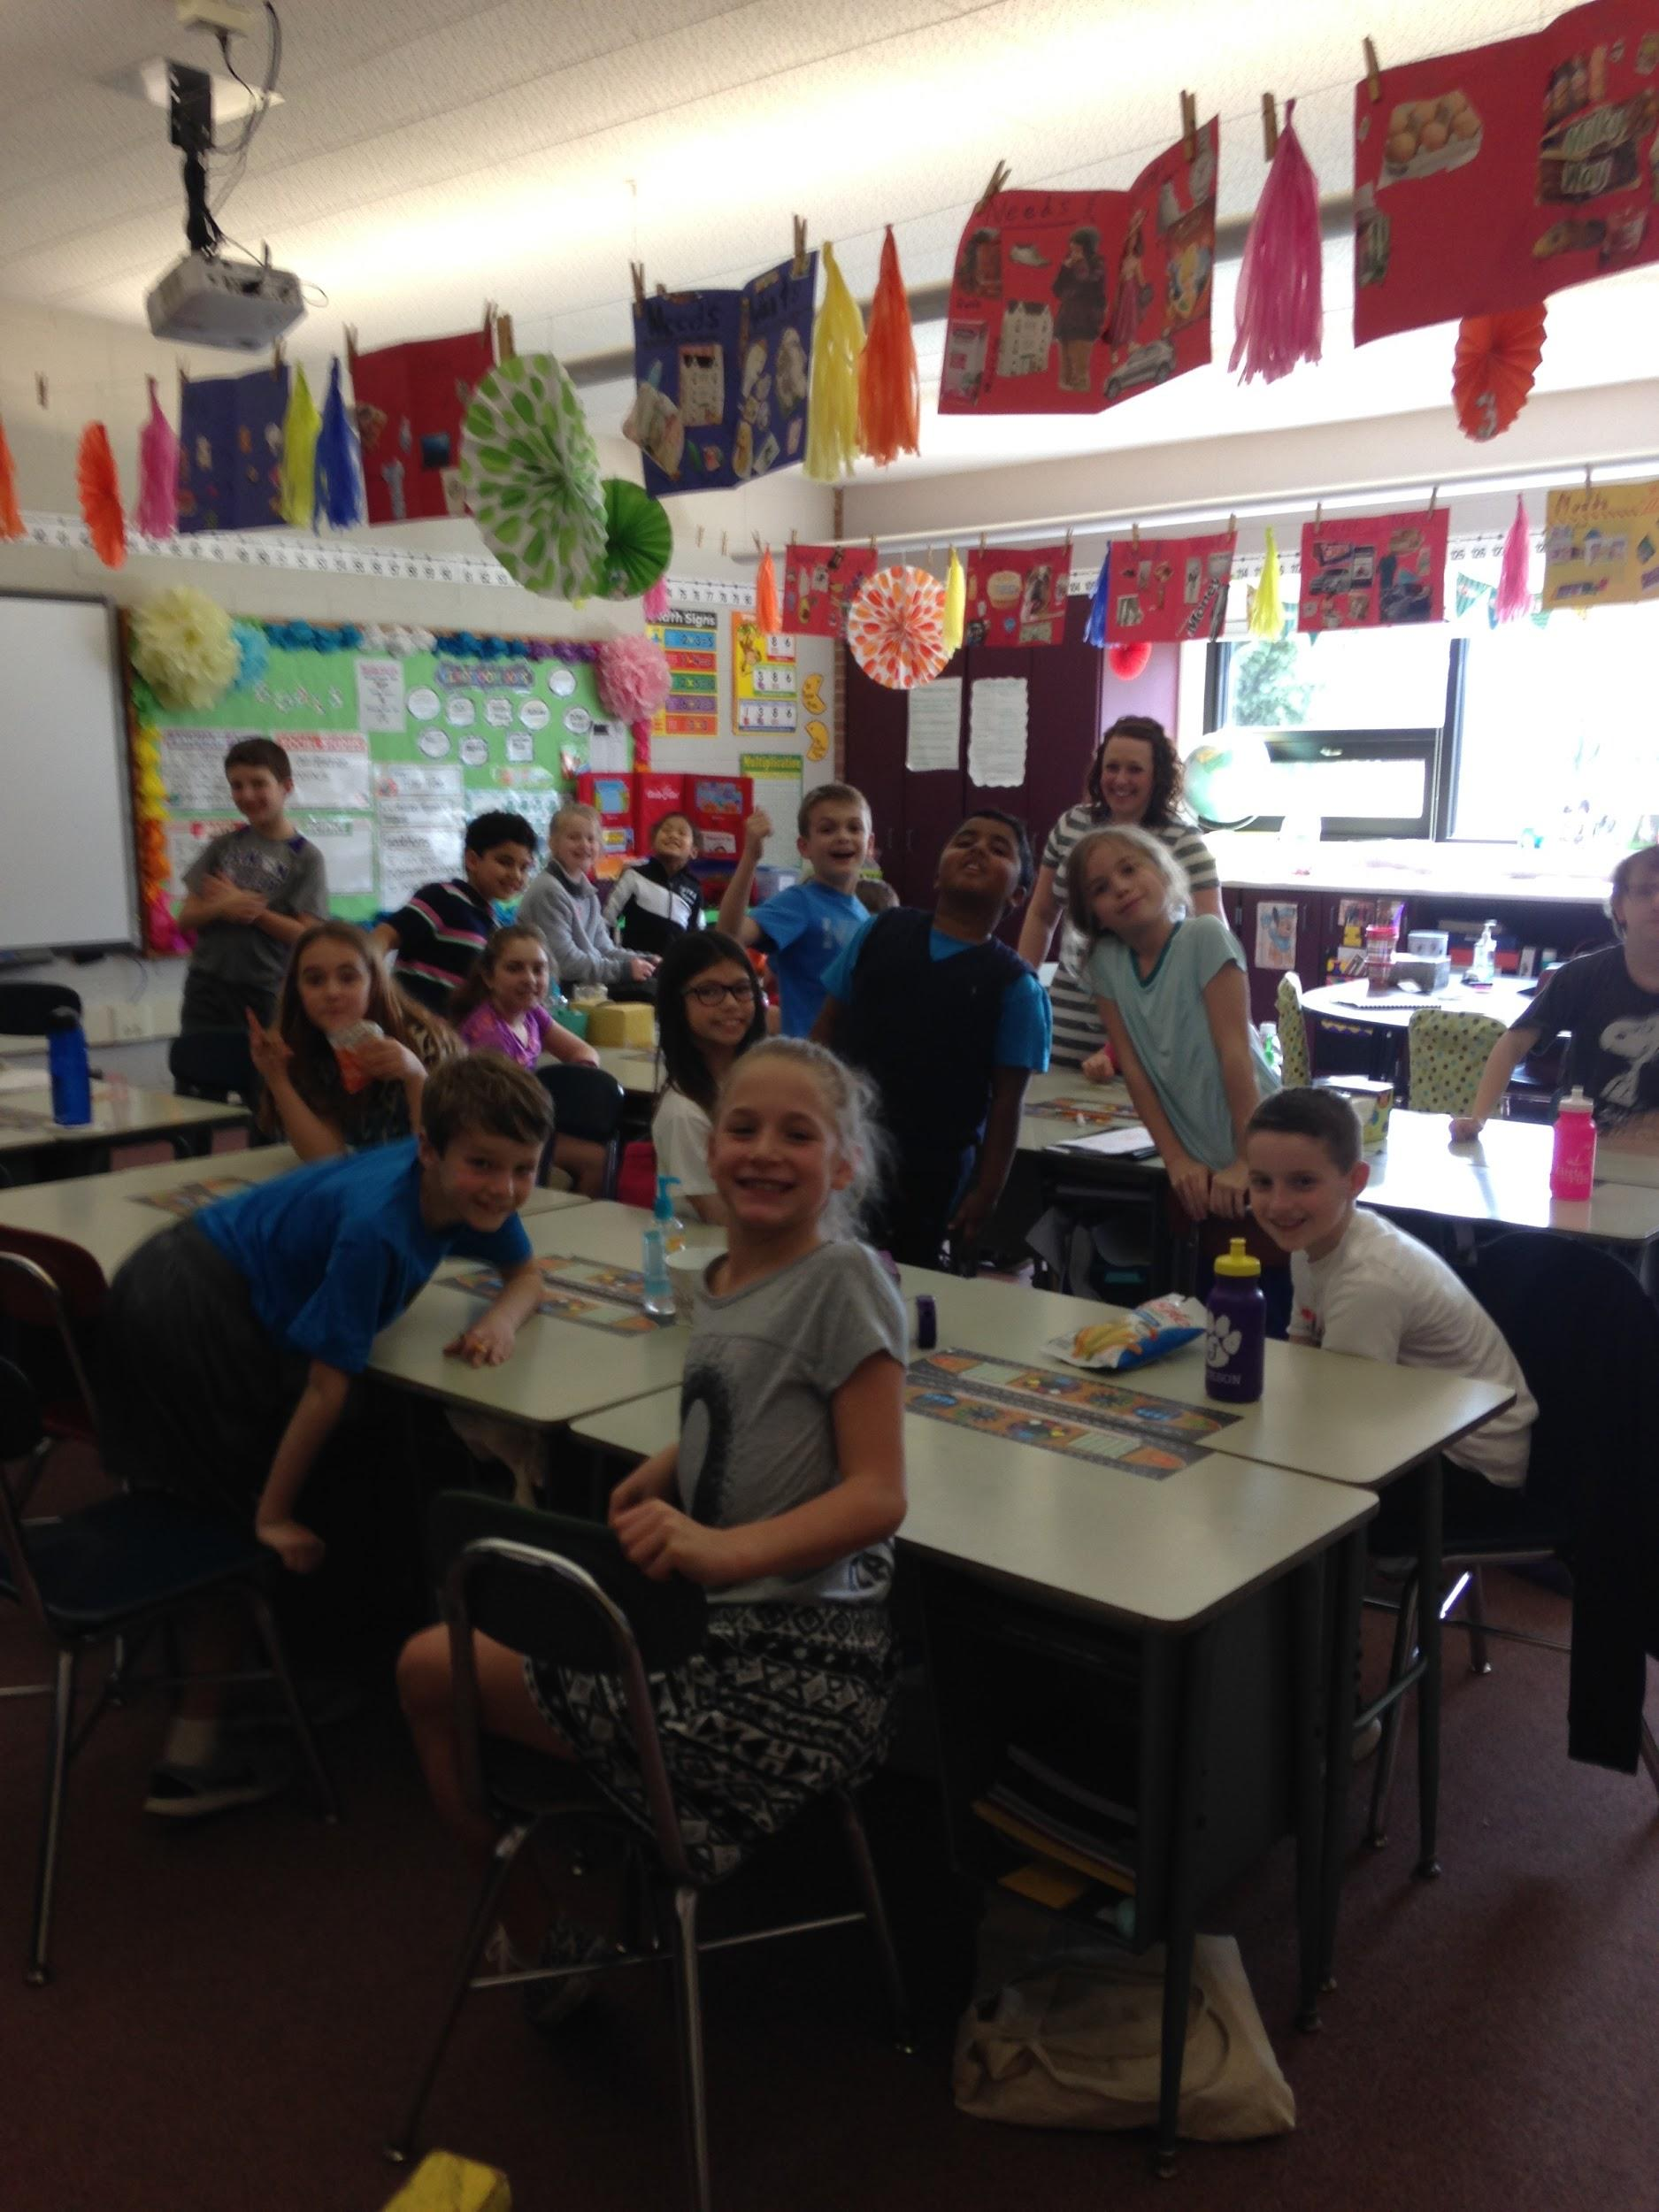
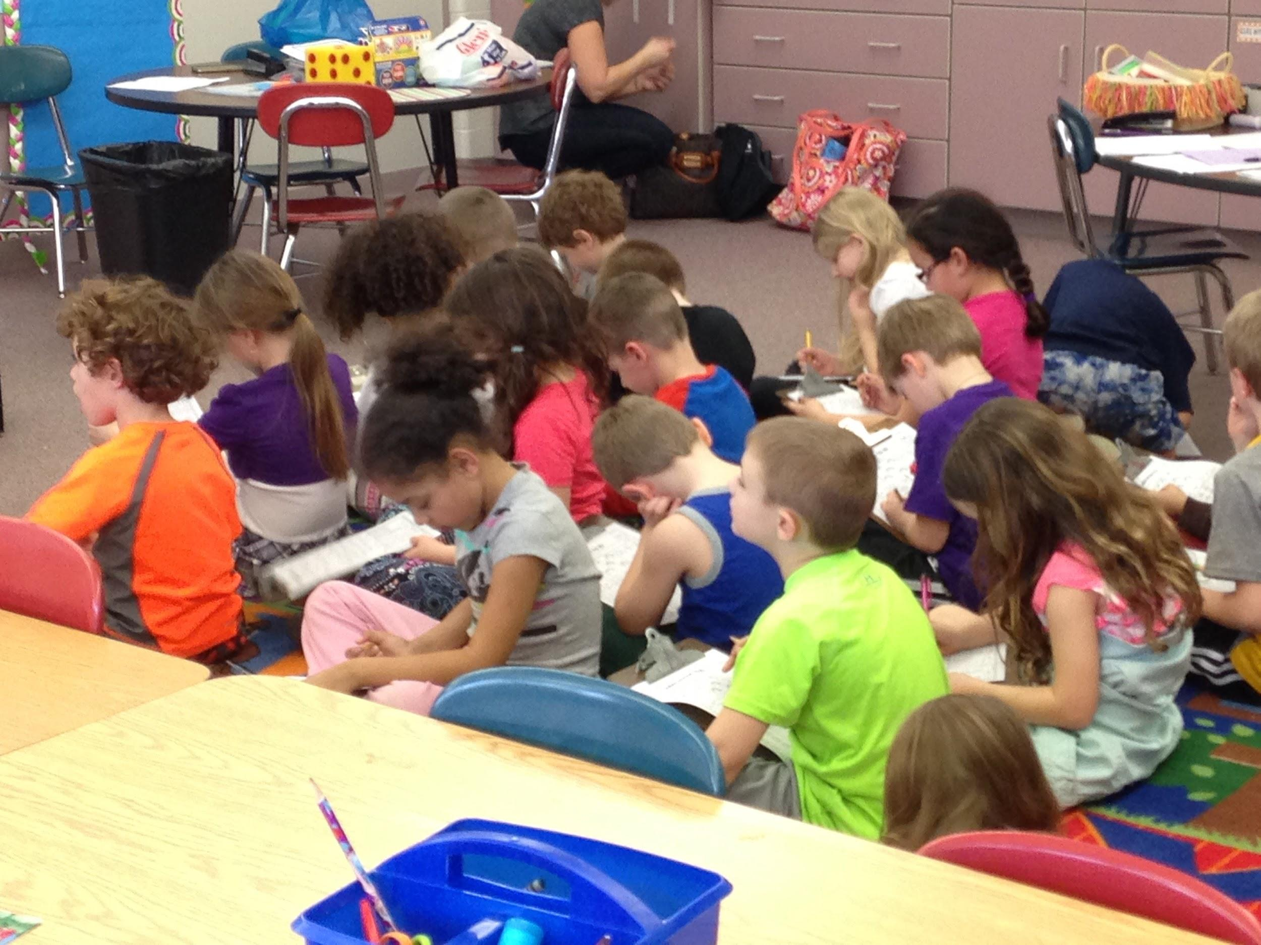
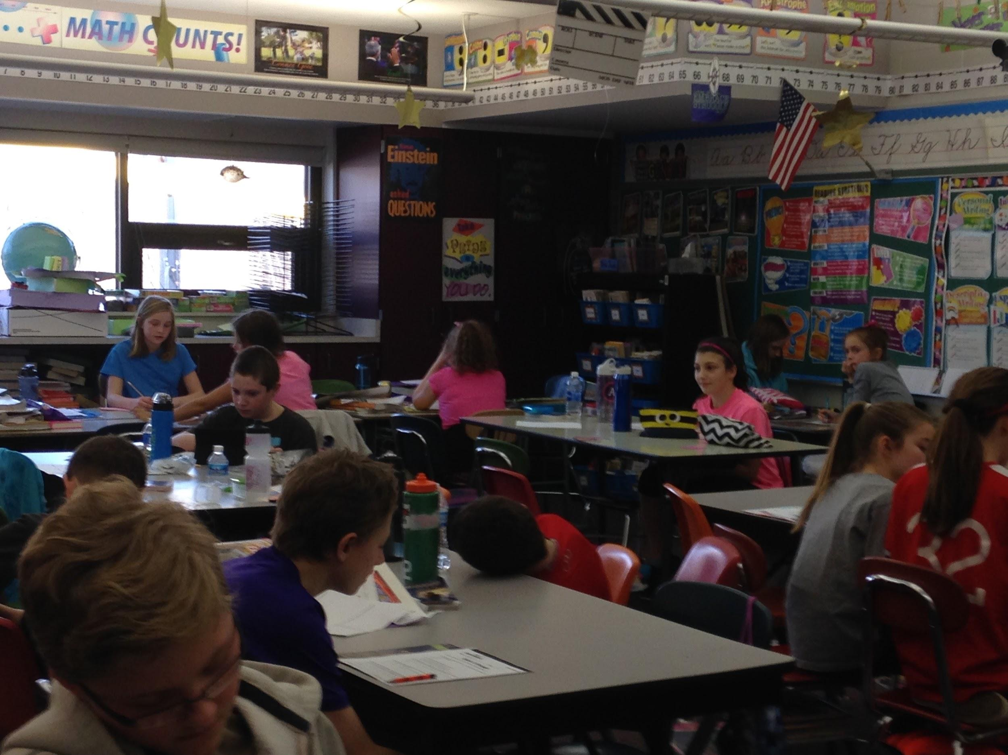
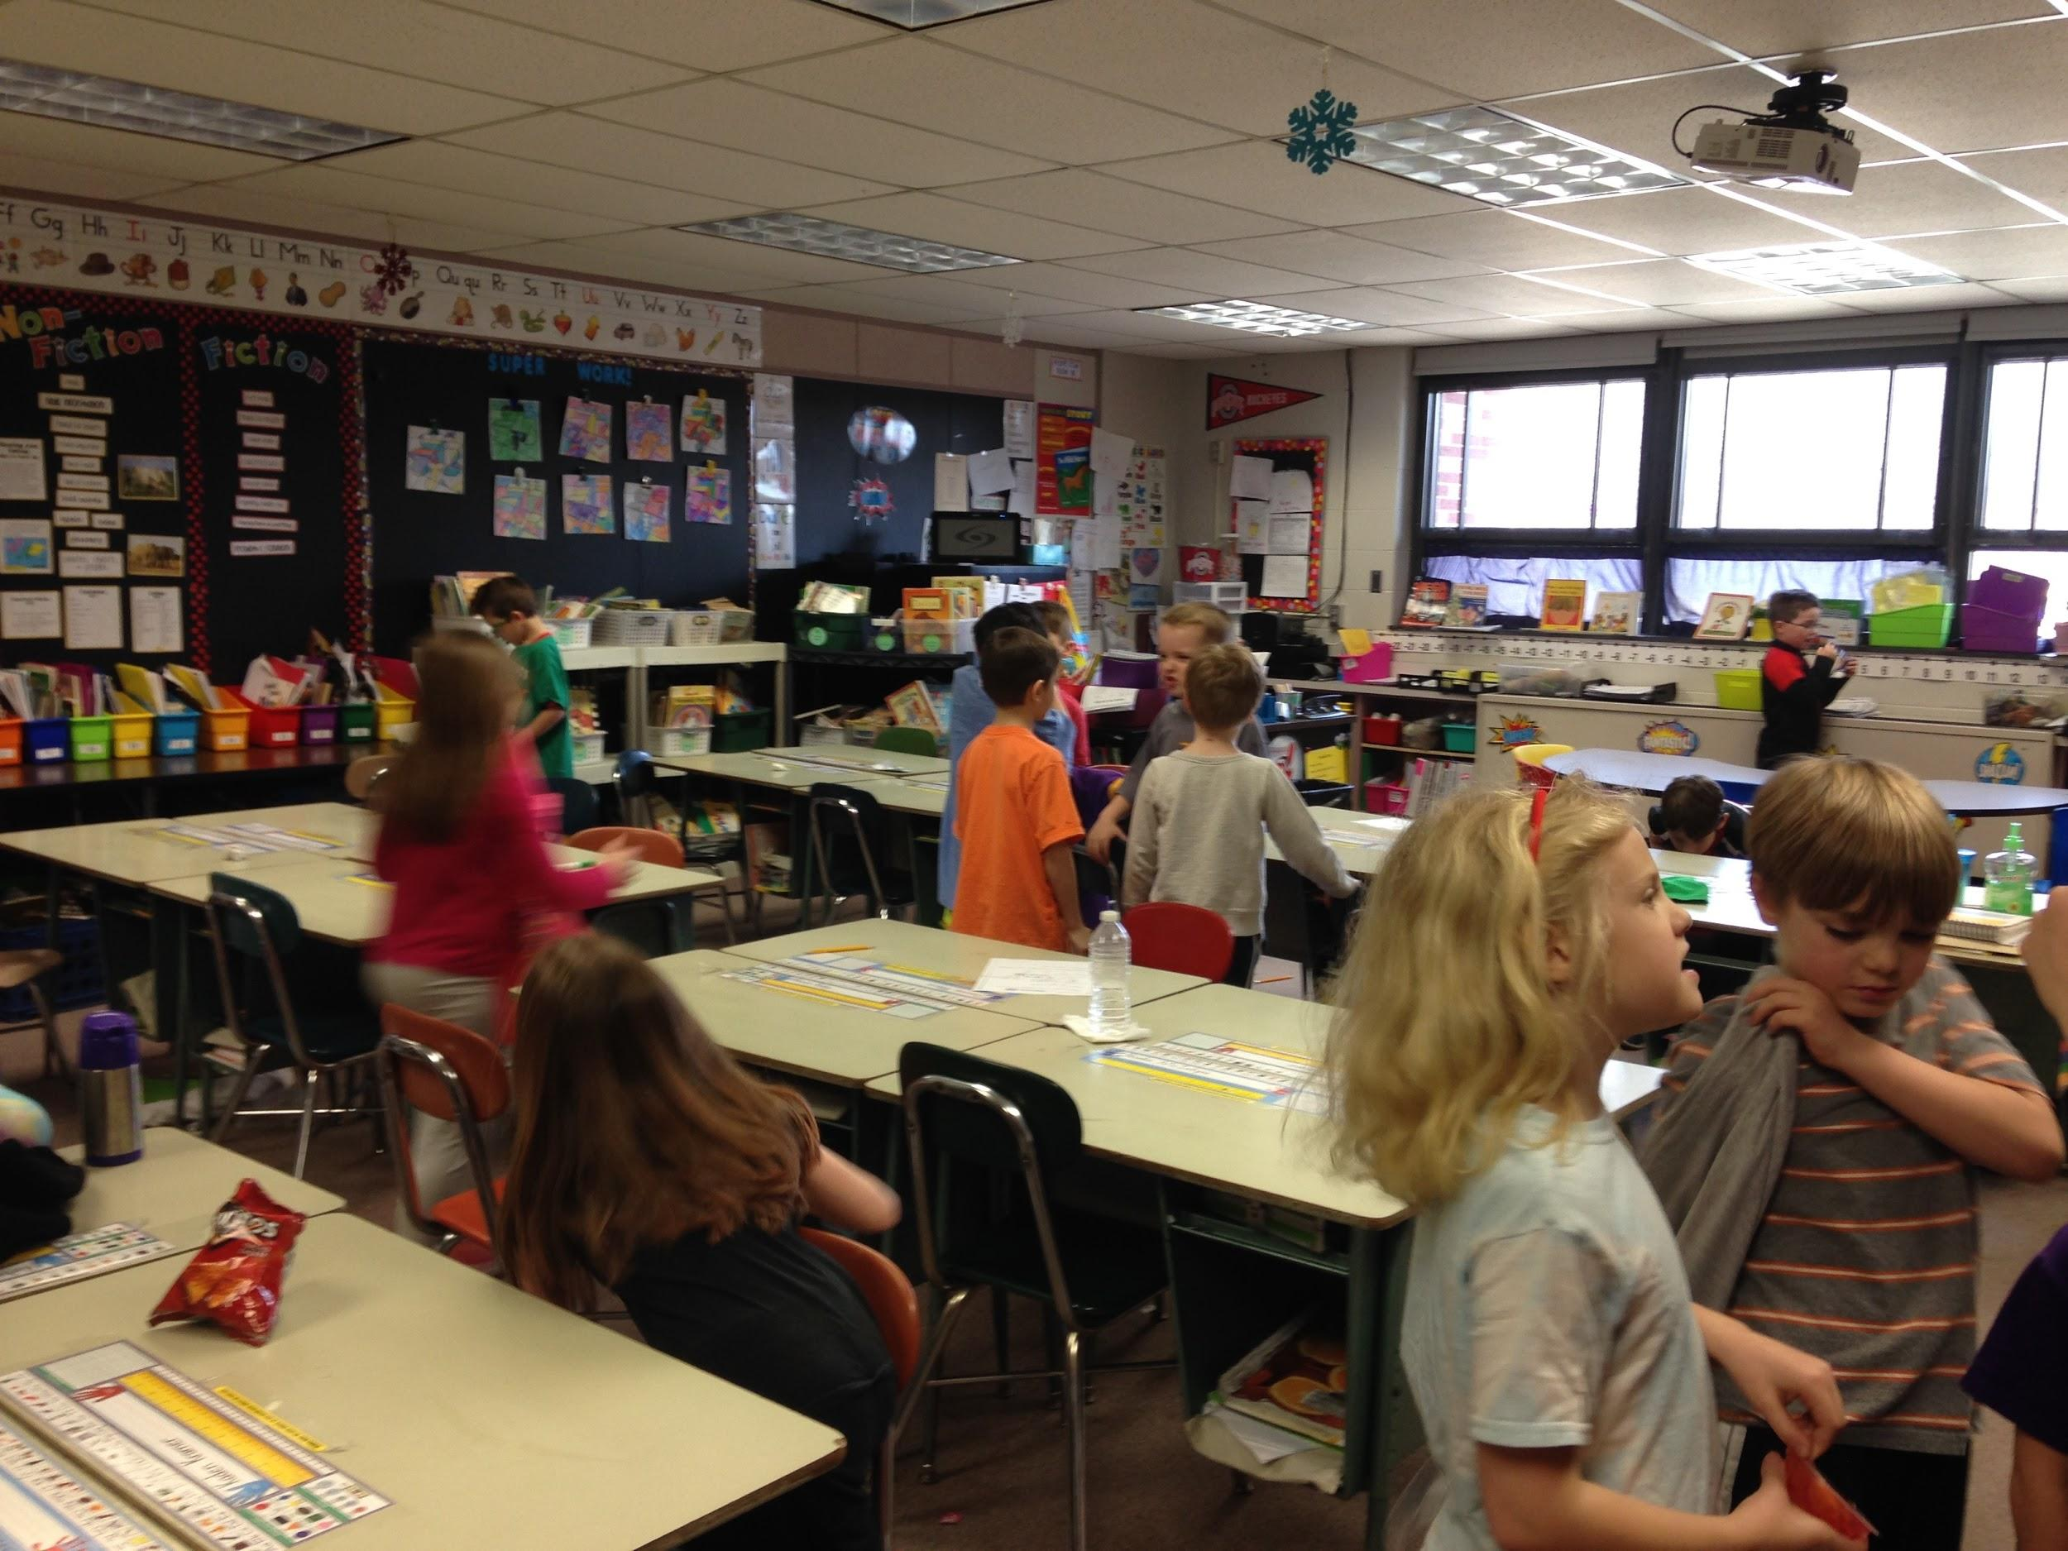
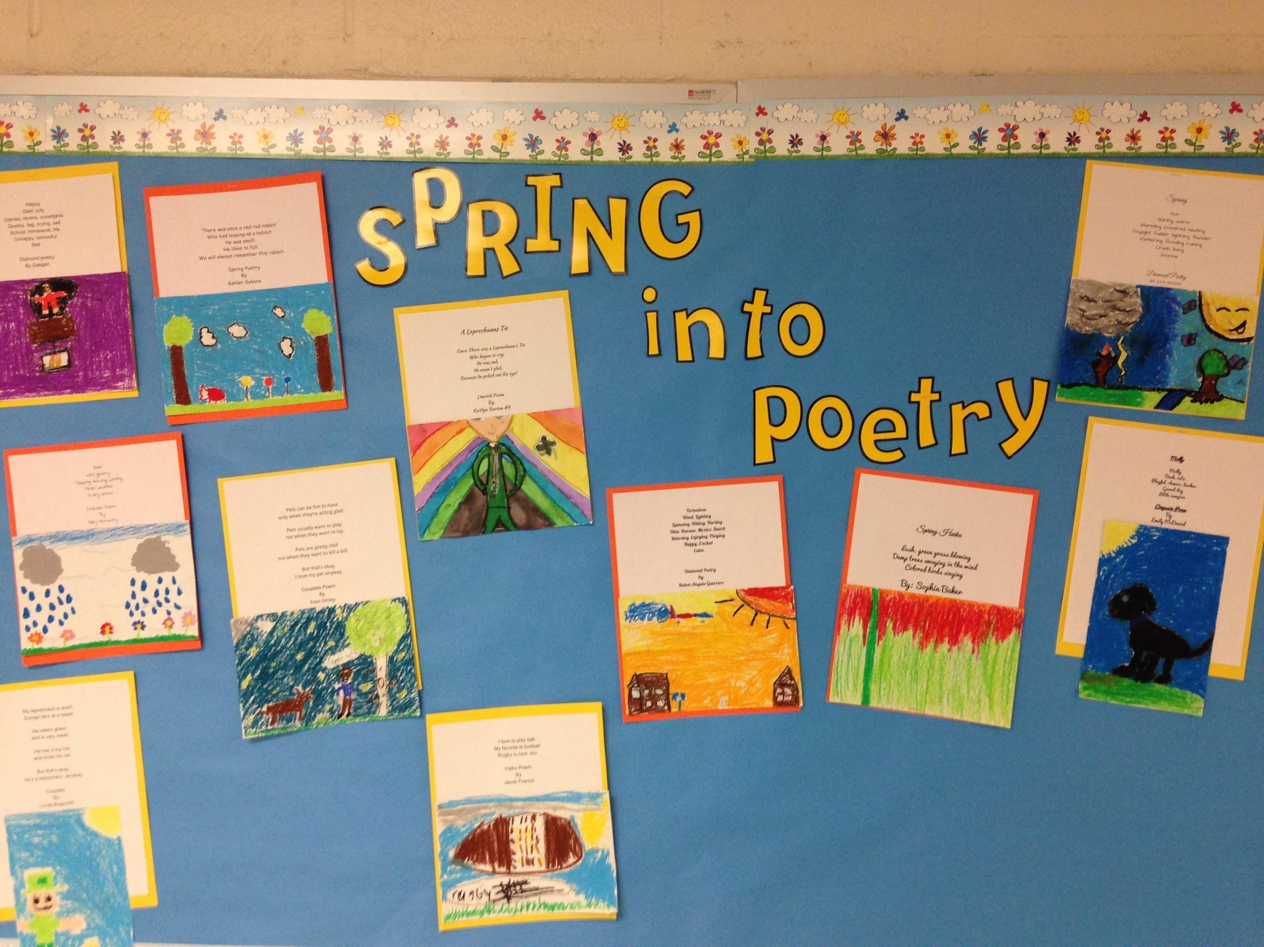
Here are some fun photos!
Notes:
I need to talk to Harley and Eric.

Slide 17
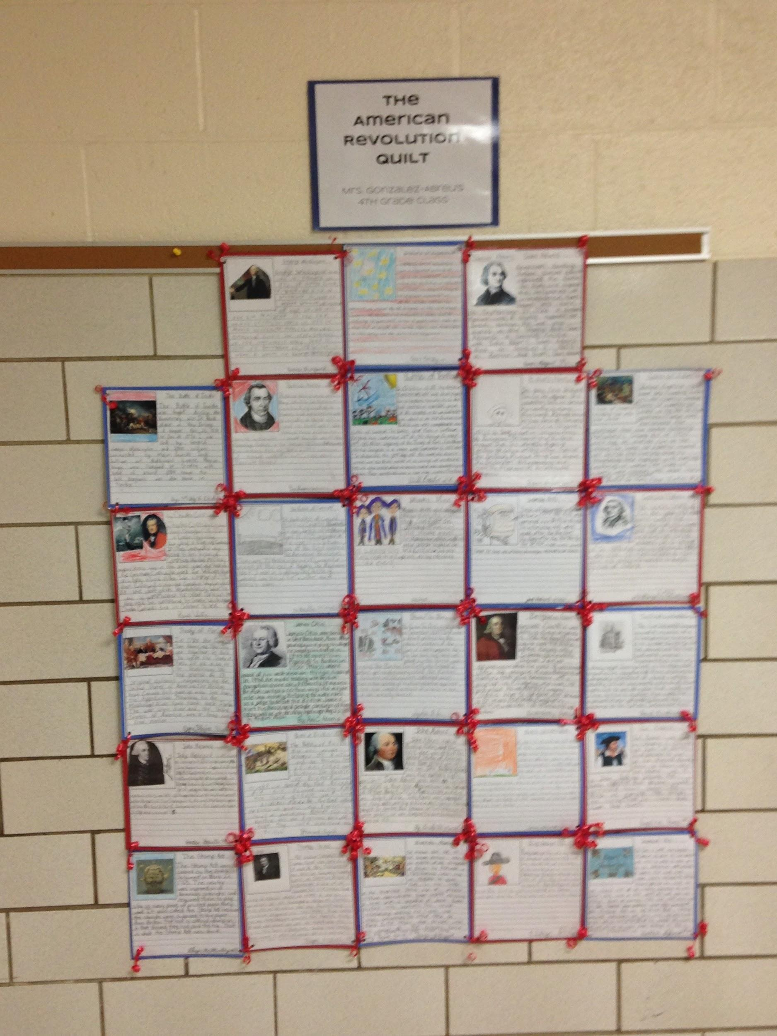
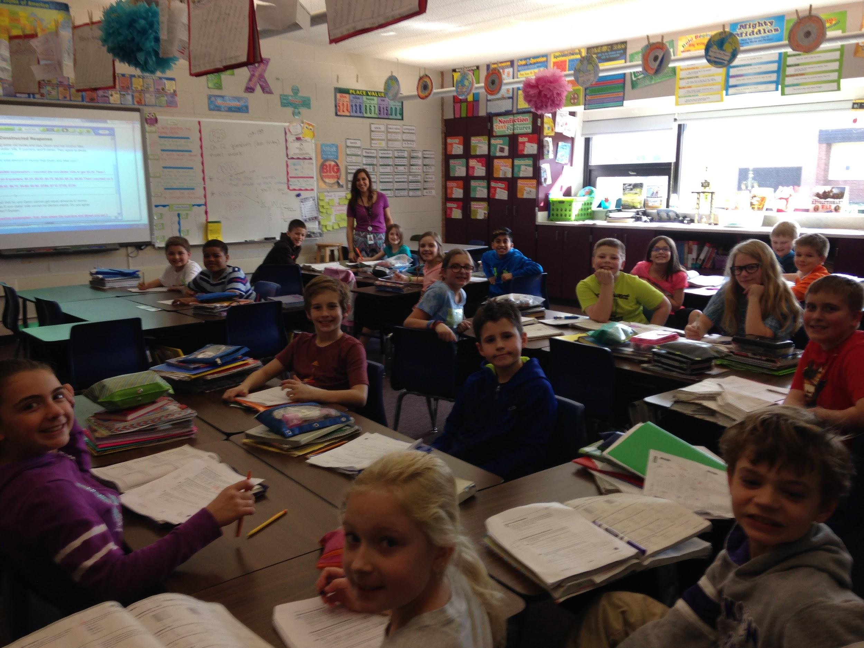
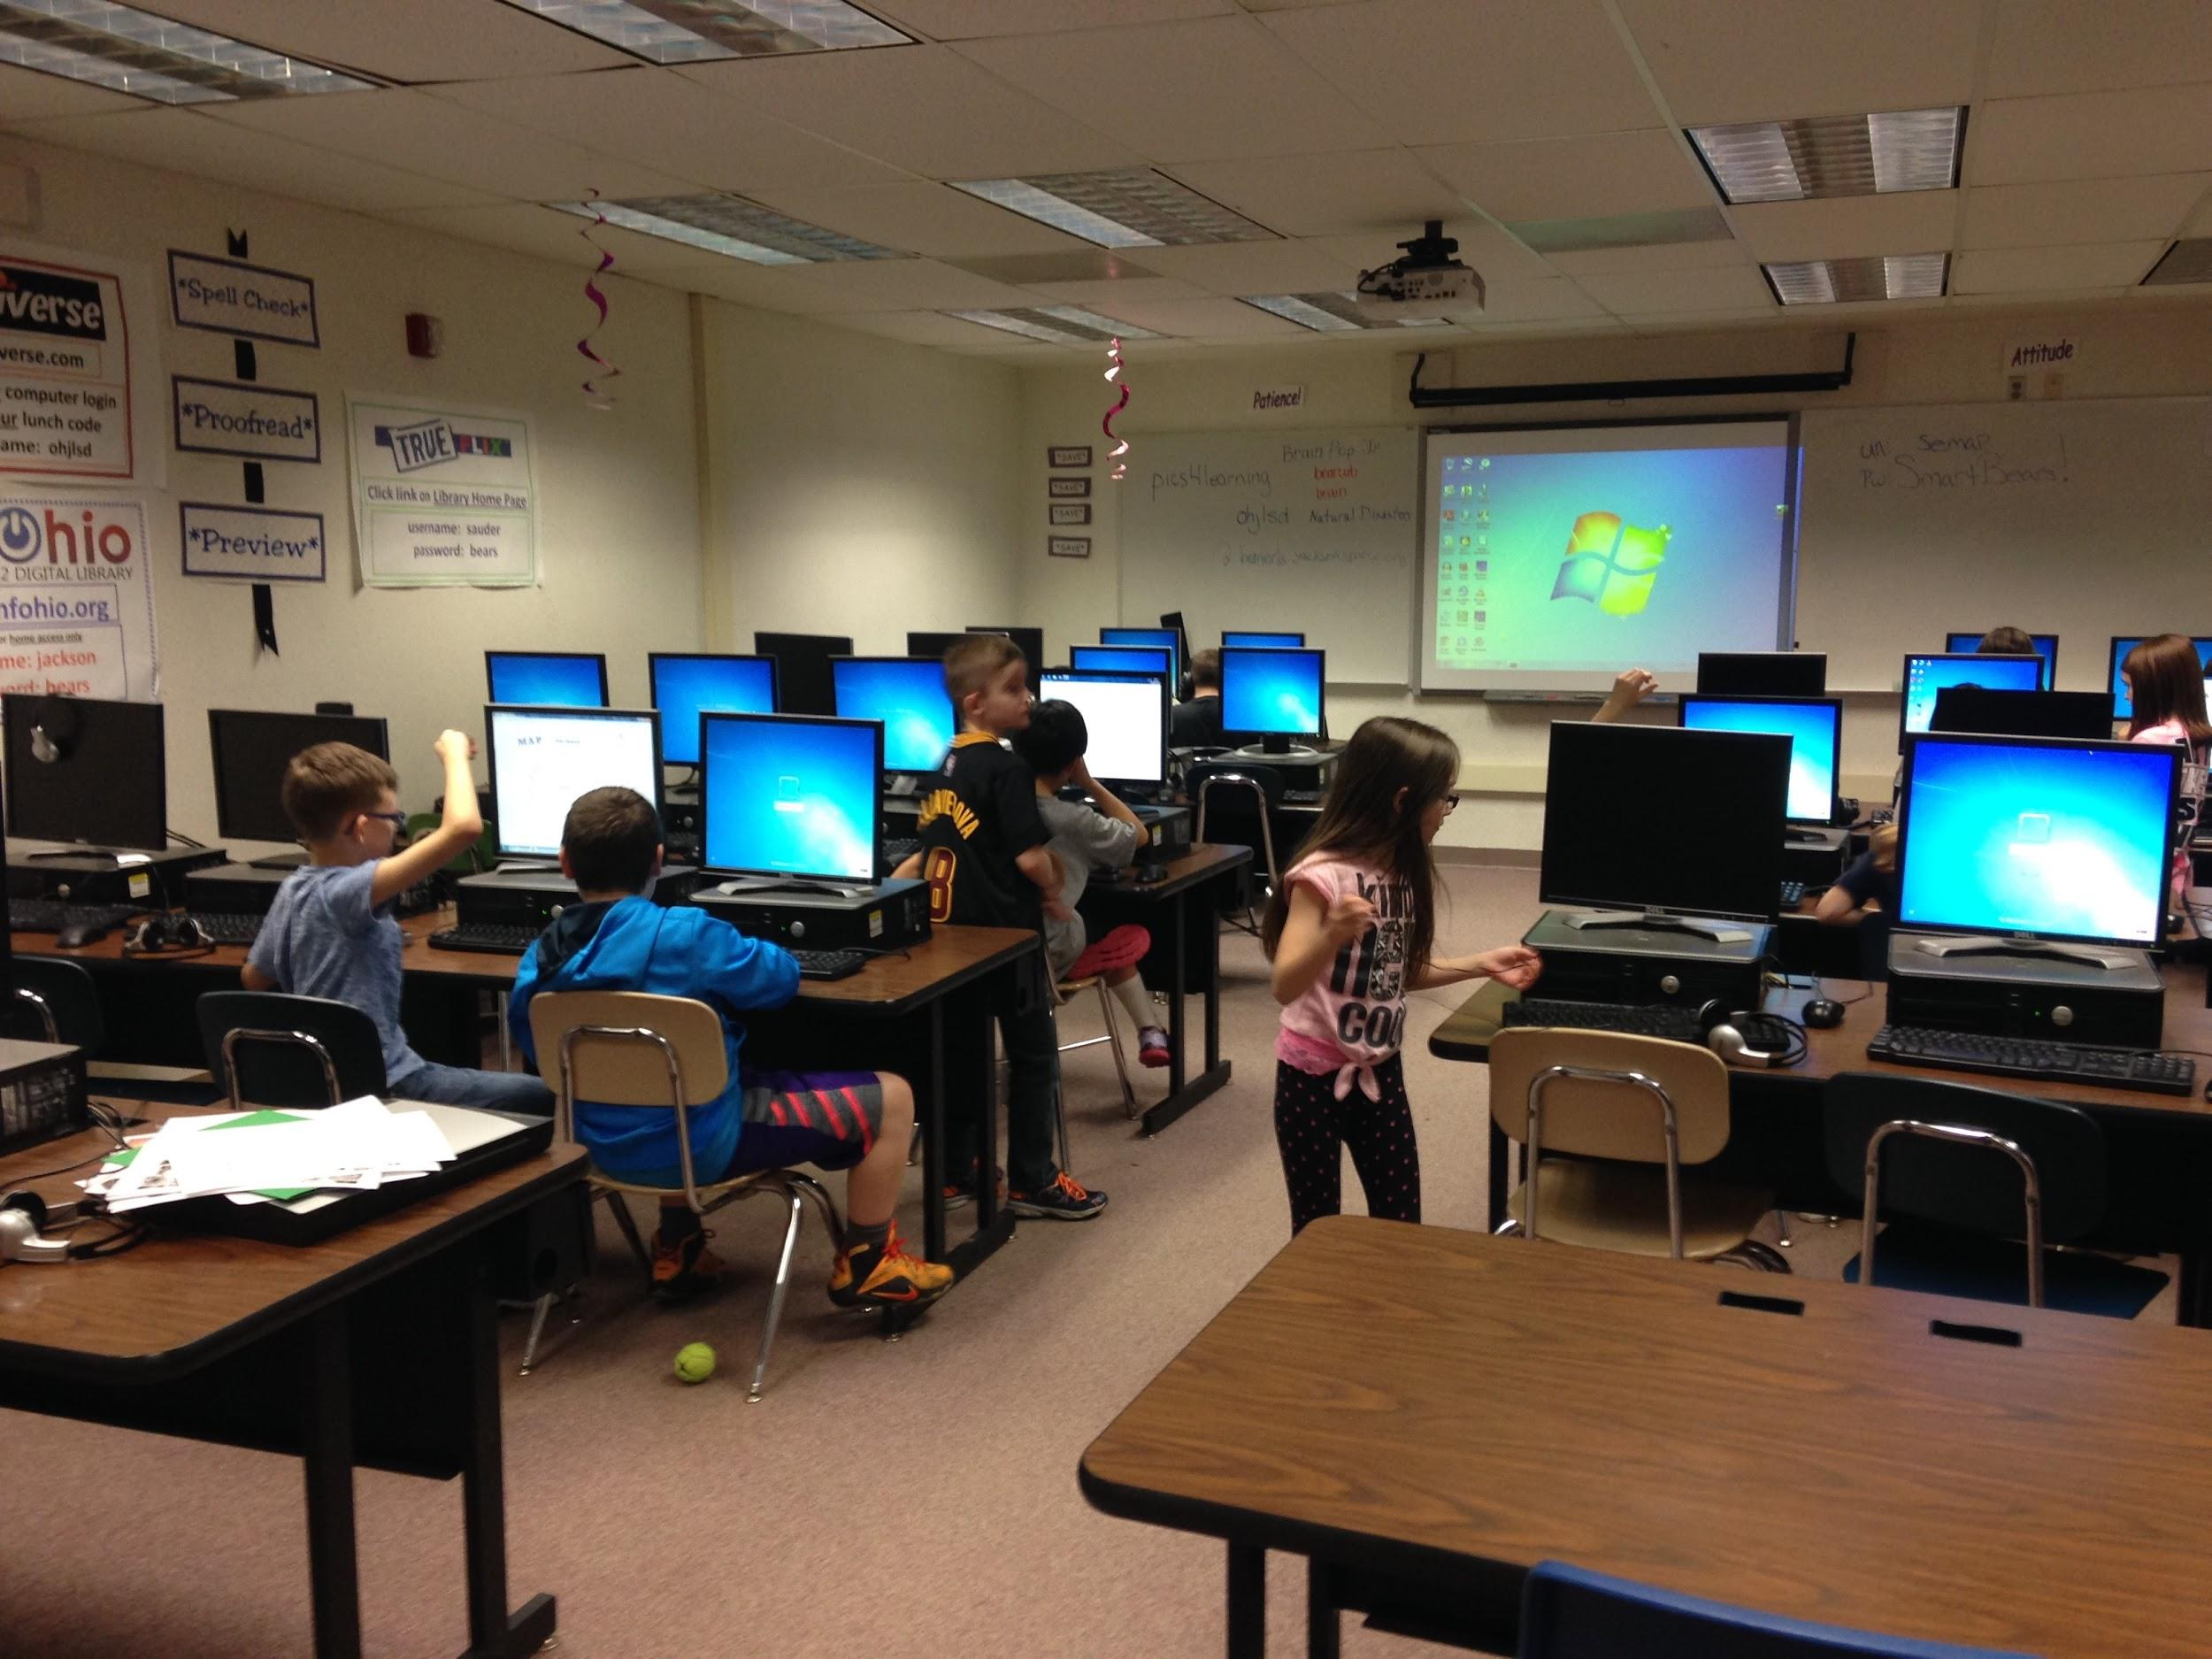
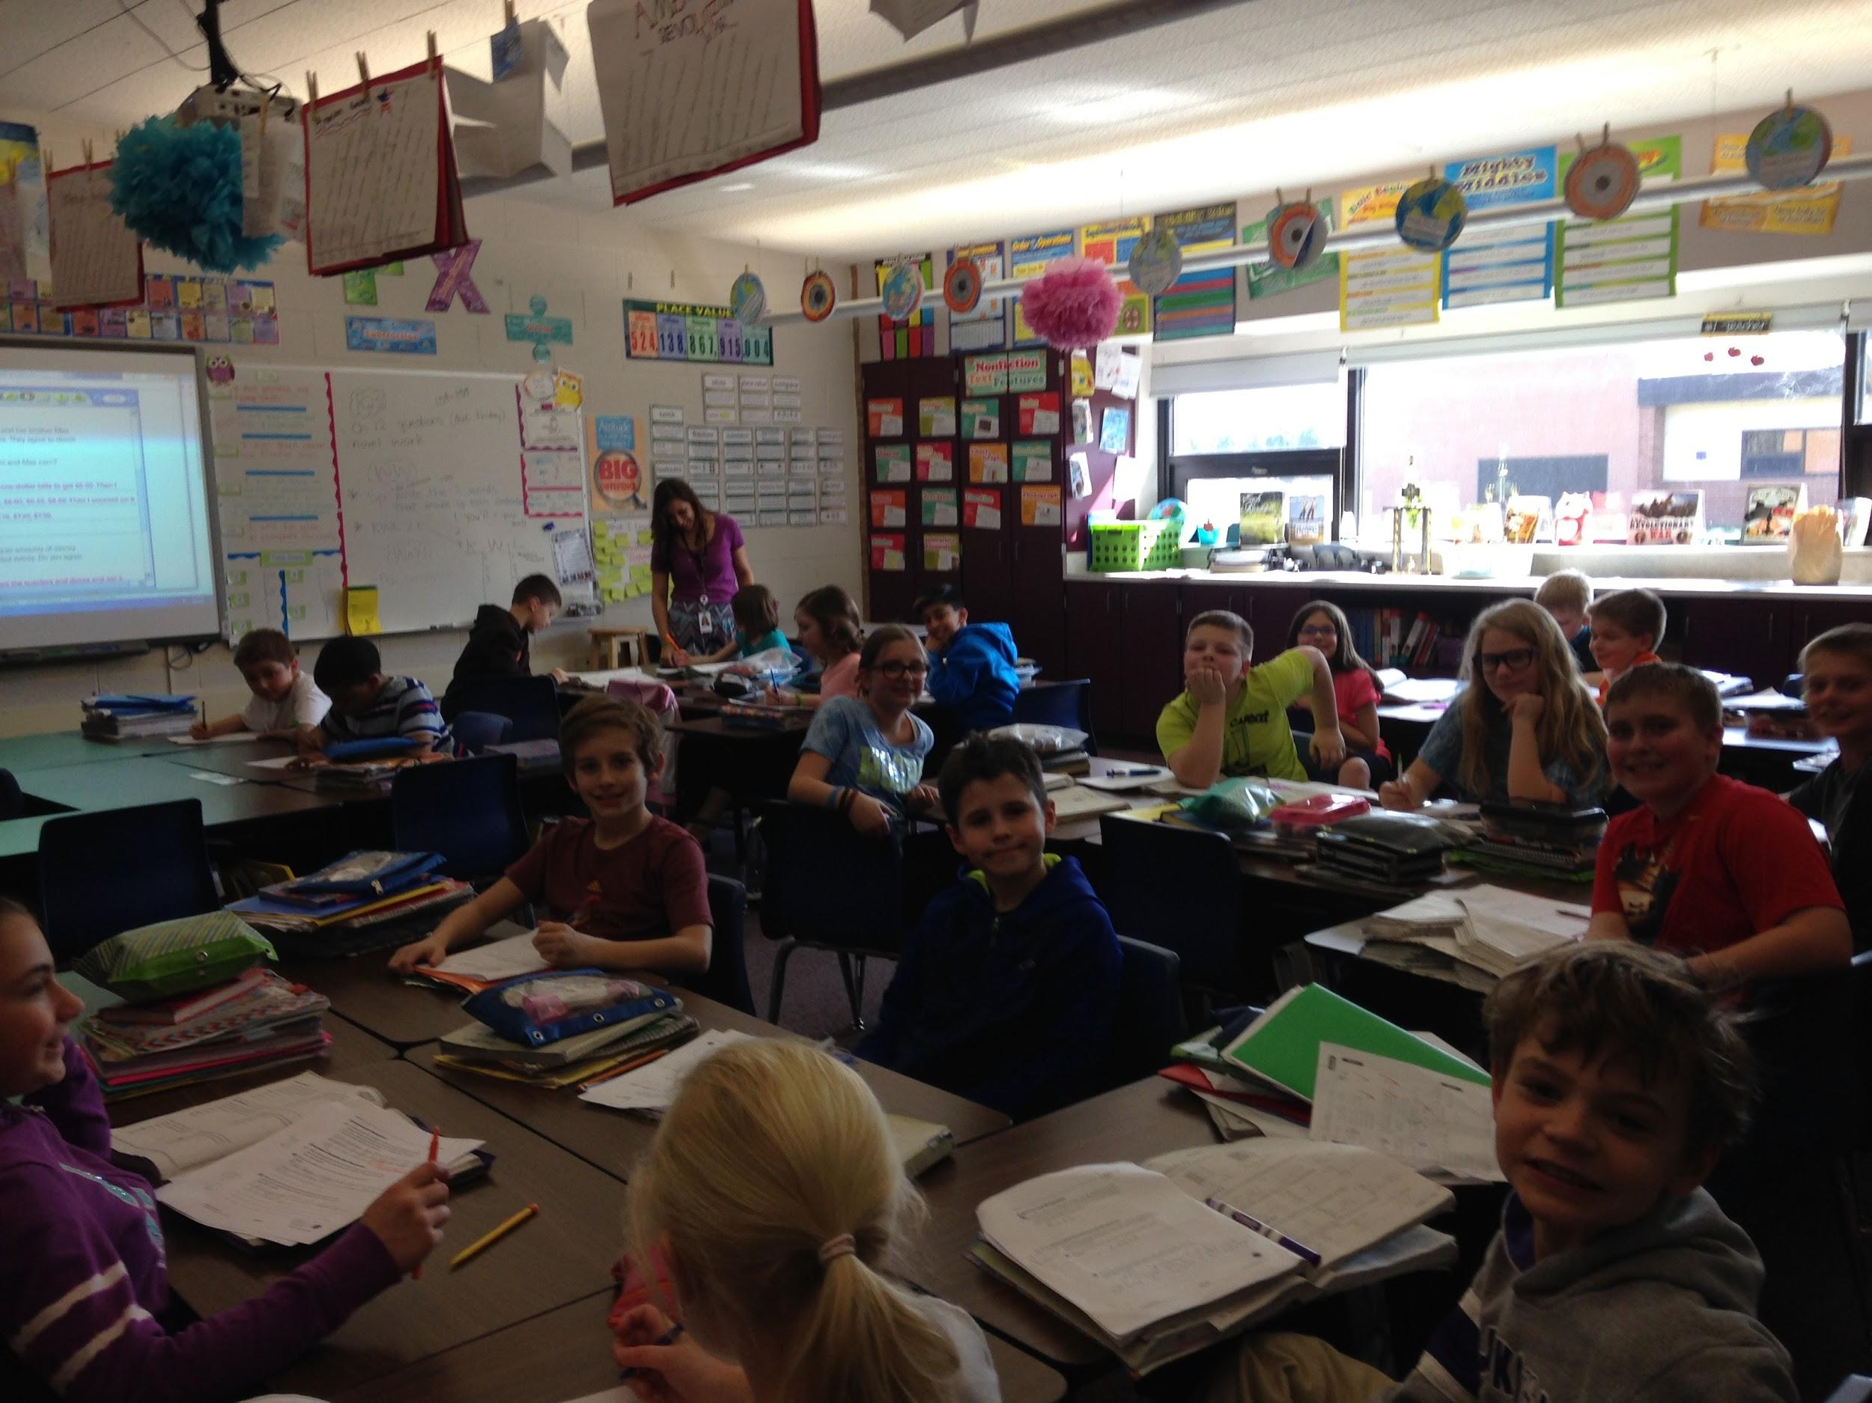
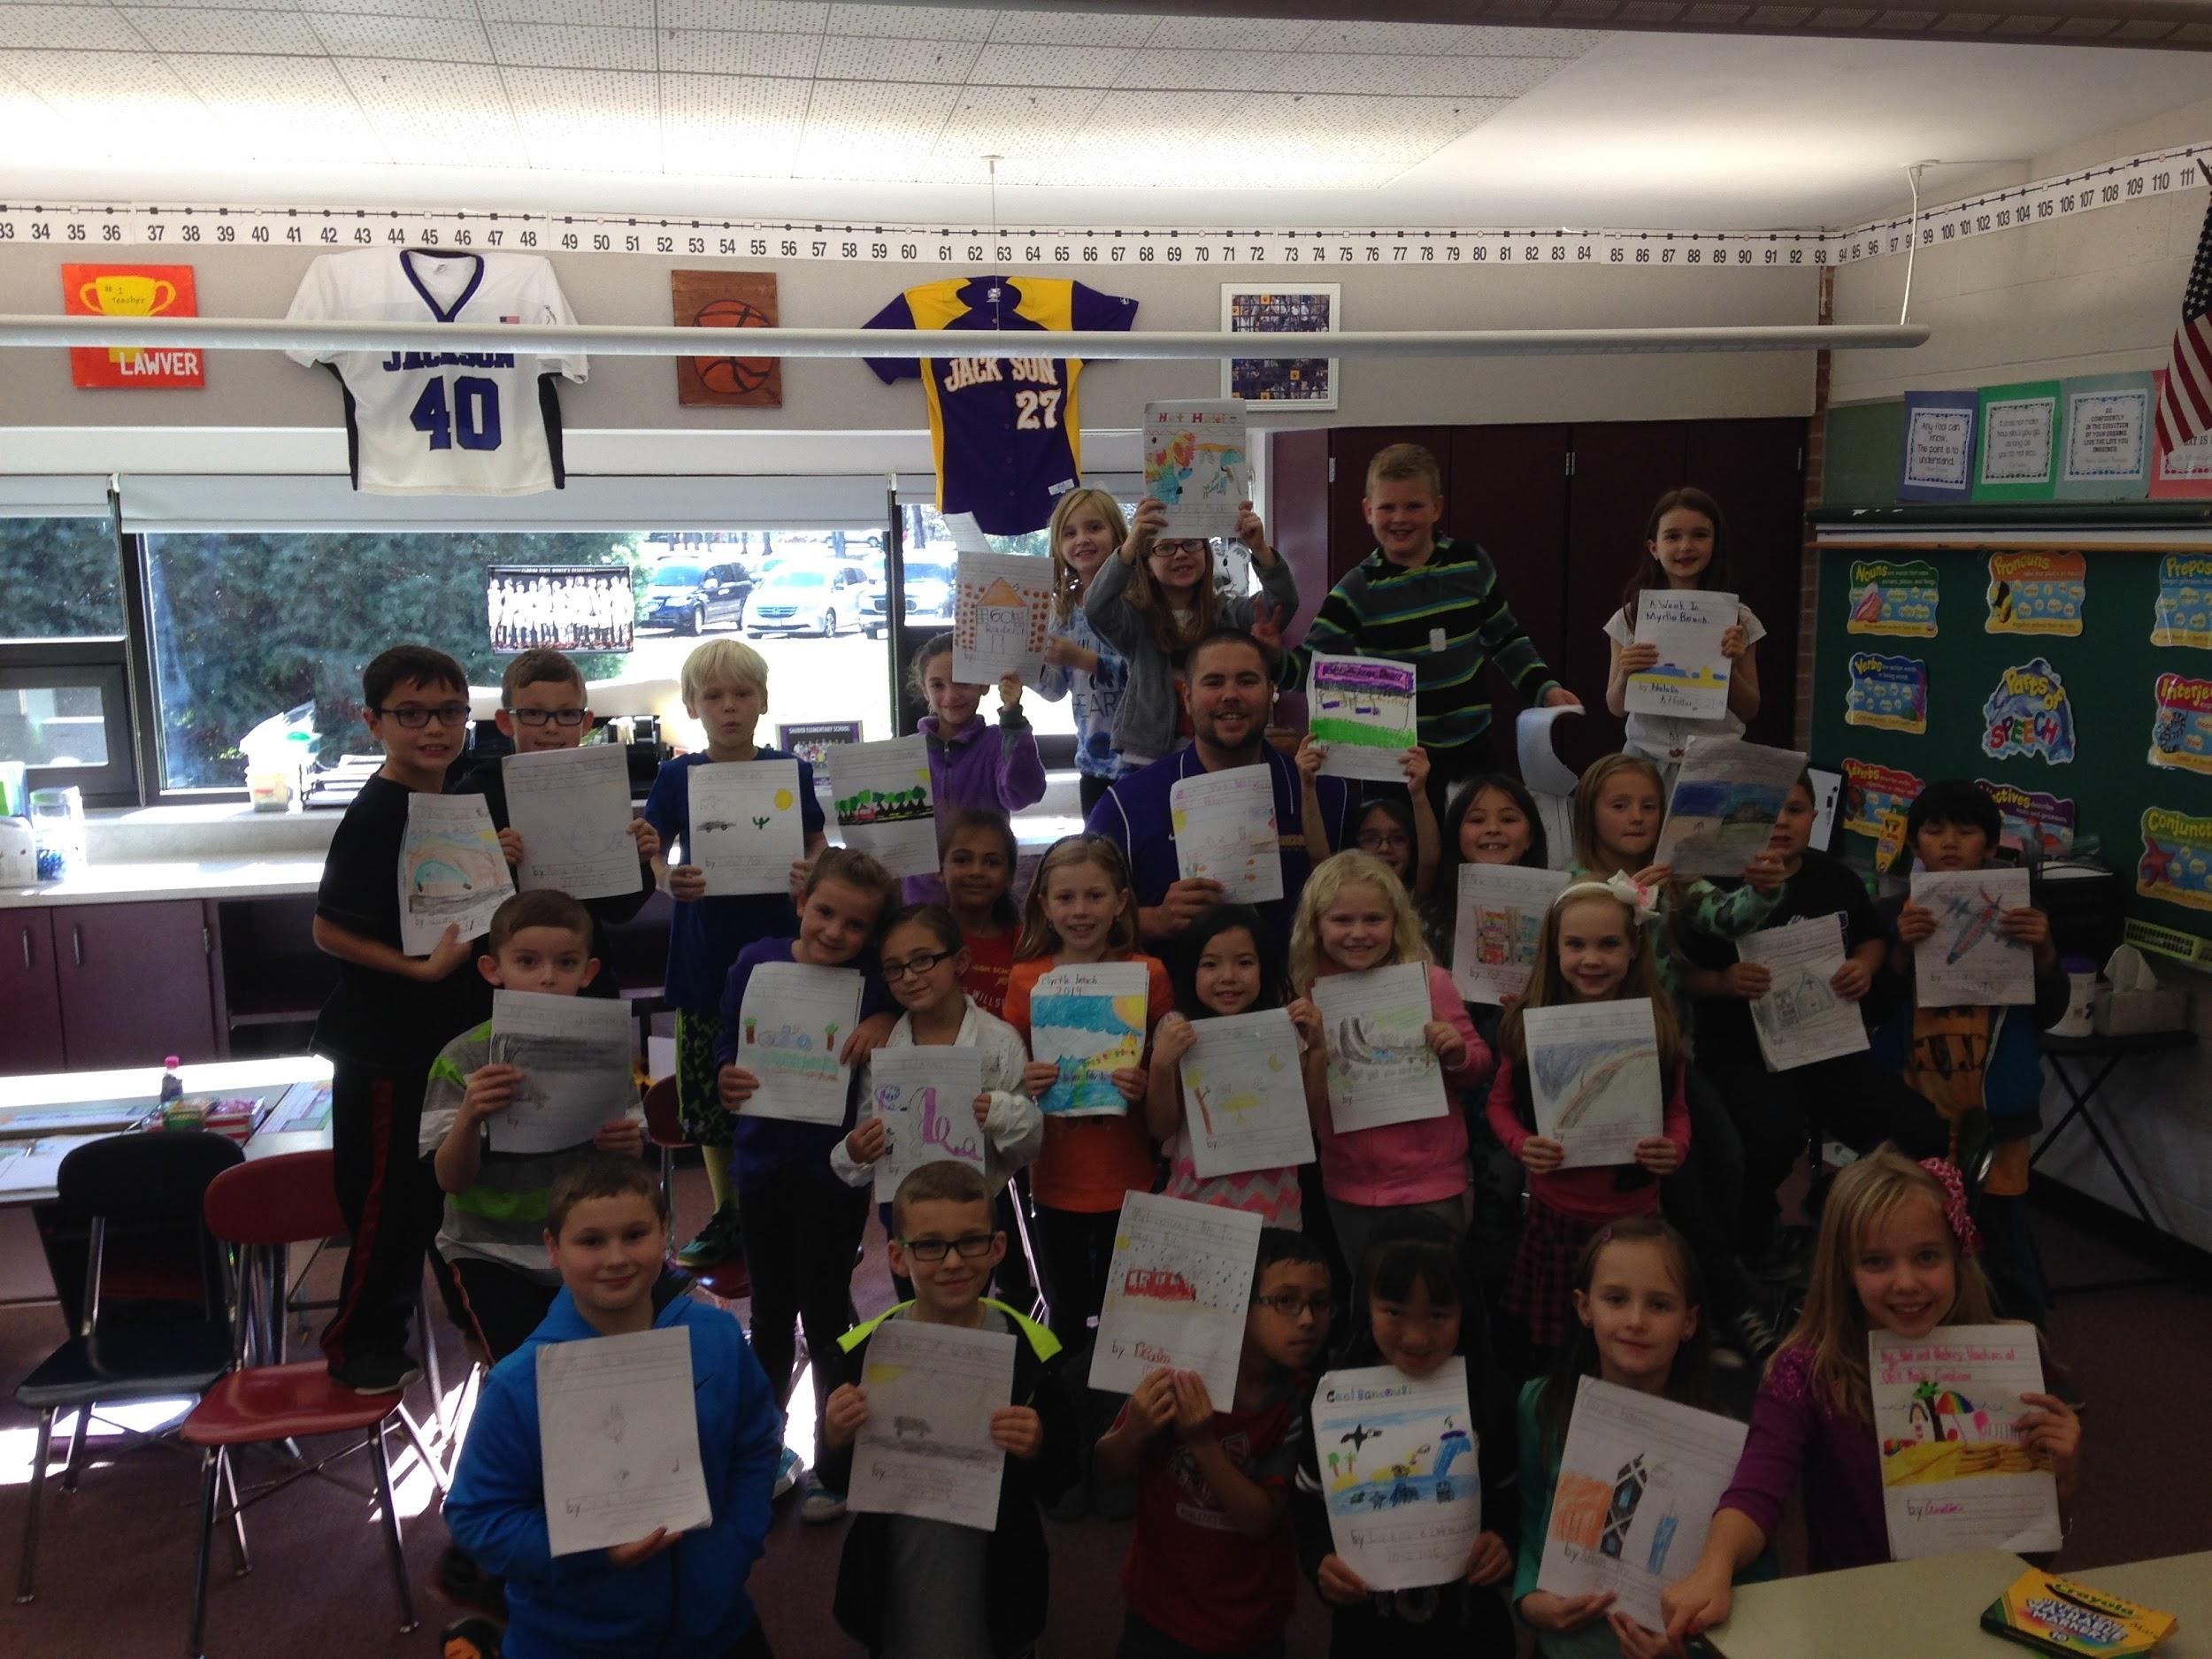
Here are some fun photos!
Notes:
I need to talk to Harley and Eric.

Slide 18
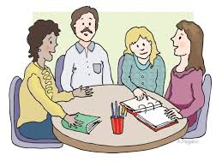
Classroom Pages
Please click here. You can access each teacher’s website!
This is a great way to stay connected to teachers in the district. You can keep up with current events and expectations!

Slide 19
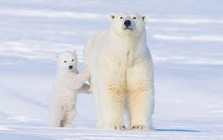
We’ll stand by you every step of the way!

