Slide 1
Composition

Slide 2
Definition:
An arrangement of the elements of an image. when done successfully it gets a viewer's attention and guides their eye throughout the image before their observation finally settles on the main subject matter of the image.

Slide 3
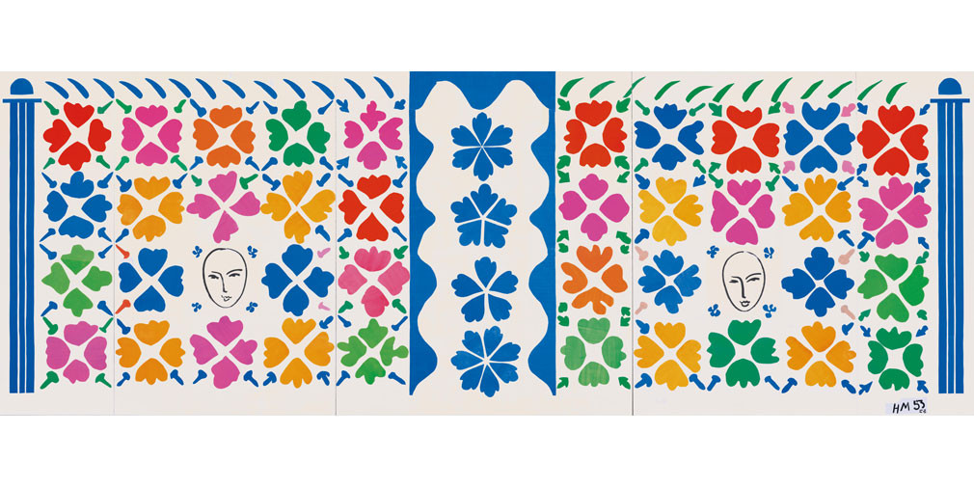
Henri Matisse “Composition is the art of arranging in a decorative manner the diverse elements at the painters command to express his feelings”

Slide 4
Rule of Thirds
A guideline that is sometime used to create a balanced composition. This is when an image is divided into three equal parts horizontally and three equal parts vertically. Important elements in a composition are then placed along these lines and their intersection points.

Slide 5
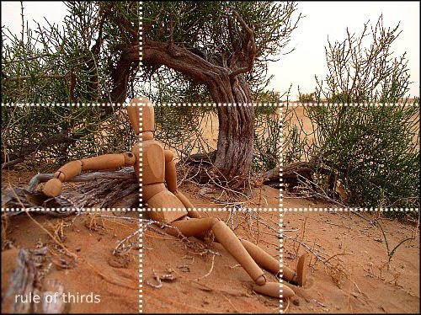

Slide 6
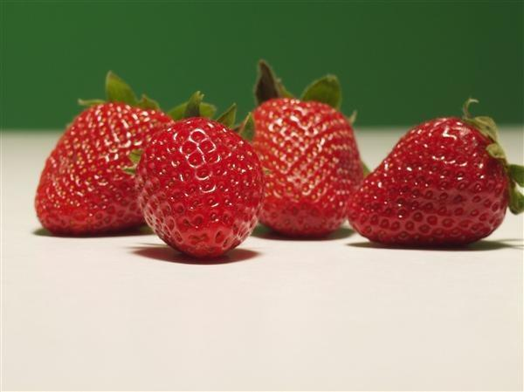
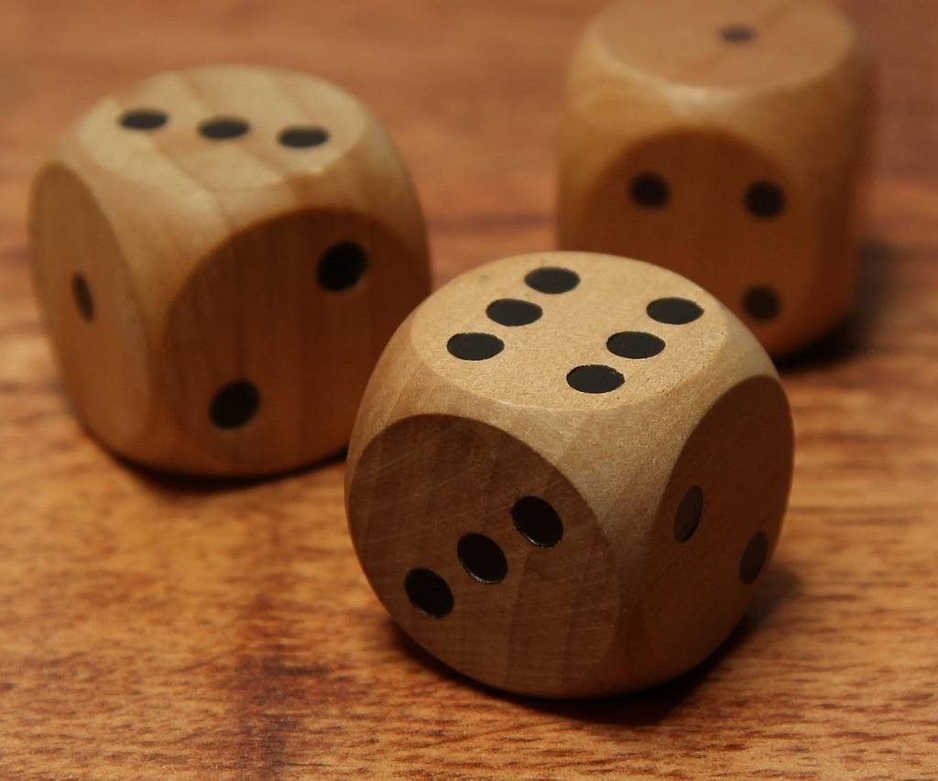
Rule of Odds
To make a composition that is more visually interesting artist will often use an odd number of elements within an image.

Slide 7
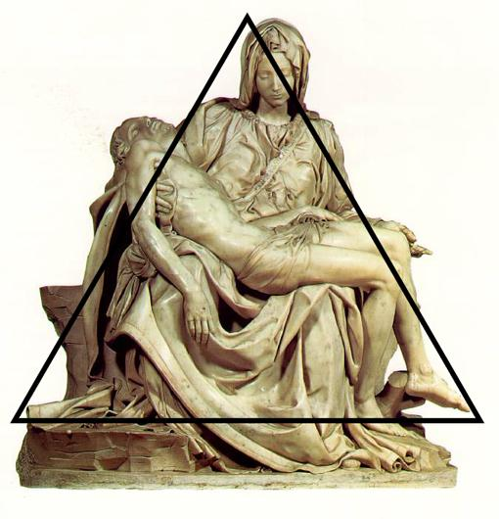
Using Geometry
Many famous artists use geometry in their art to make it more pleasing to the eye. the most pleasing shapes to incorporate in your composition is a triangle.

